Slide 1
Contents
This is a tutorial for TCC-GUI.
TCC-GUI GitHub page
prerequisites, standalone version, and online version
Data Simulation (Step 0)
Exploratory Analysis (Step 1)
TCC Computation (Step 2)
Visualization (Step 3)
MA Plot, Volcano Plot
Heatmap, Expression Level
Report (Step 4)

Slide 2
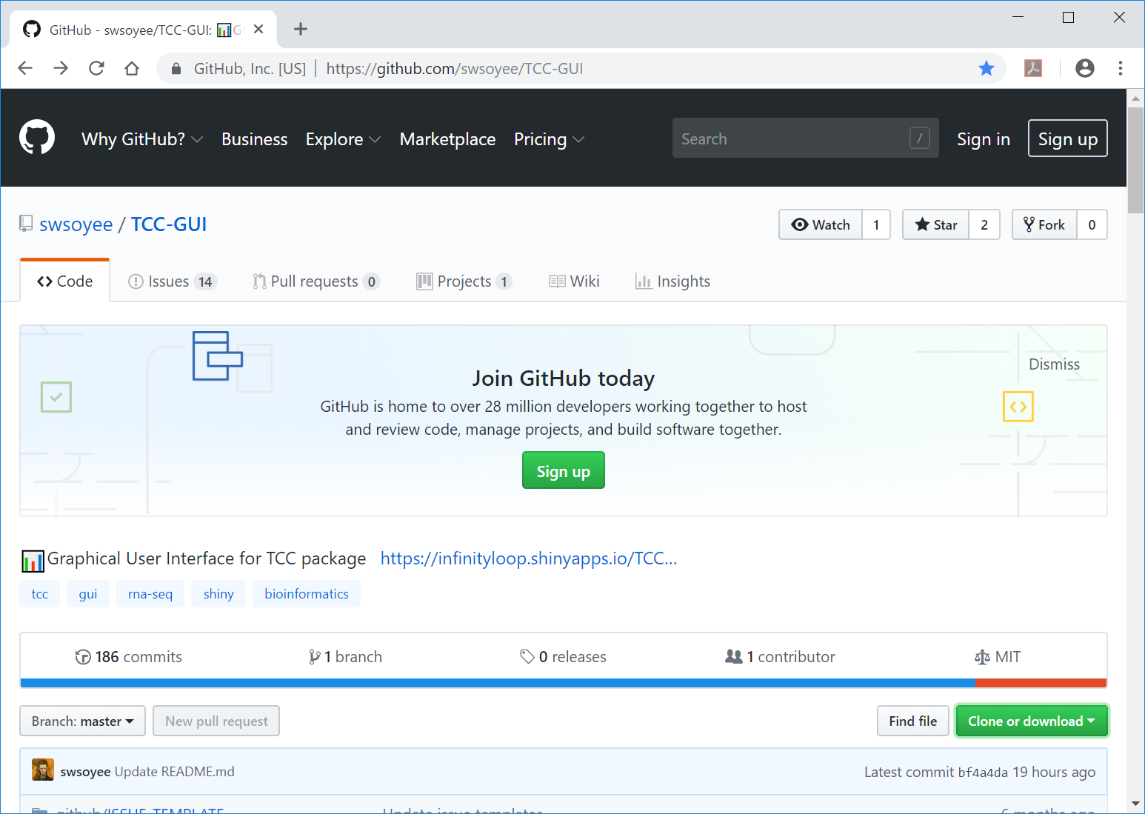
TCC-GUI GitHub page
①TCC-GUI GitHub page. ②Move to the bottom of this page.
②
①
https://github.com/swsoyee/TCC-GUI

Slide 3
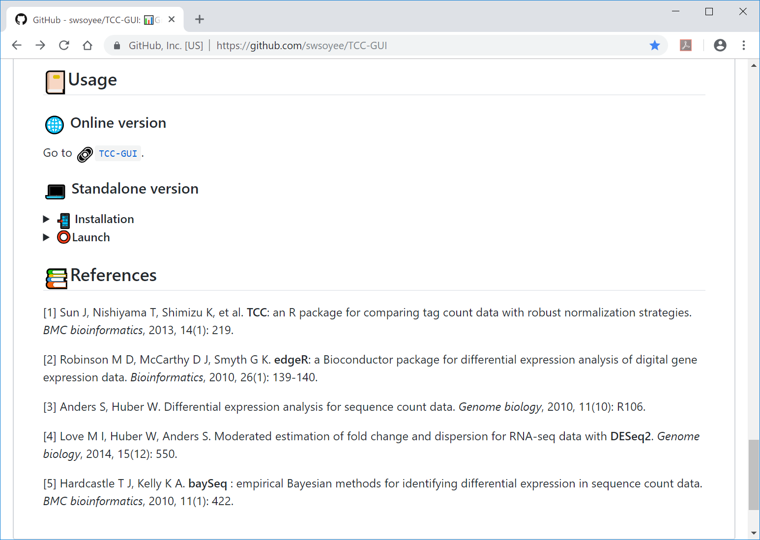
Standalone version
①When using the standalone version, ②the user must install all the necessary packages in advance before launch.
①
②

Slide 4
Online version
①The online version can be launched here.
①

Slide 5
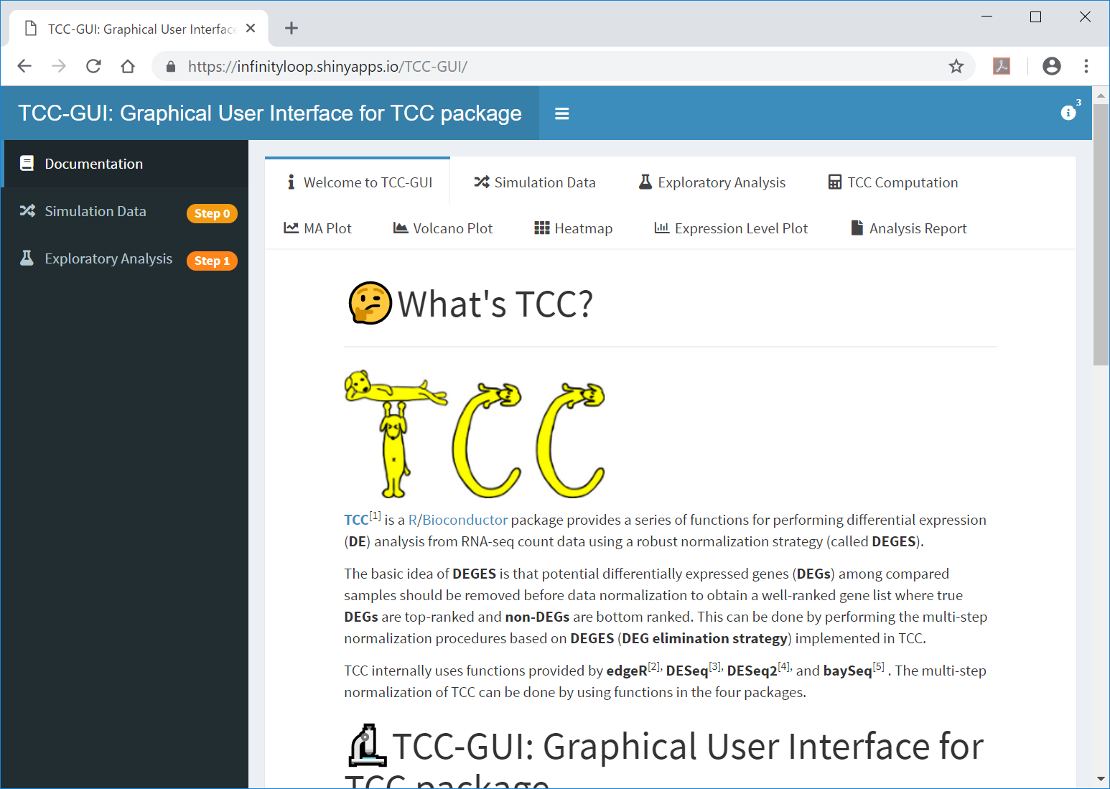
Online version
①The initial screen of TCC-GUI.
https://infinityloop.shinyapps.io/TCC-GUI/

Slide 6
Contents
TCC-GUI GitHub page
prerequisites, standalone version, and online version
Data Simulation (Step 0)
Exploratory Analysis (Step 1)
TCC Computation (Step 2)
Visualization (Step 3)
MA Plot, Volcano Plot
Heatmap, Expression Level
Report (Step 4)

Slide 7
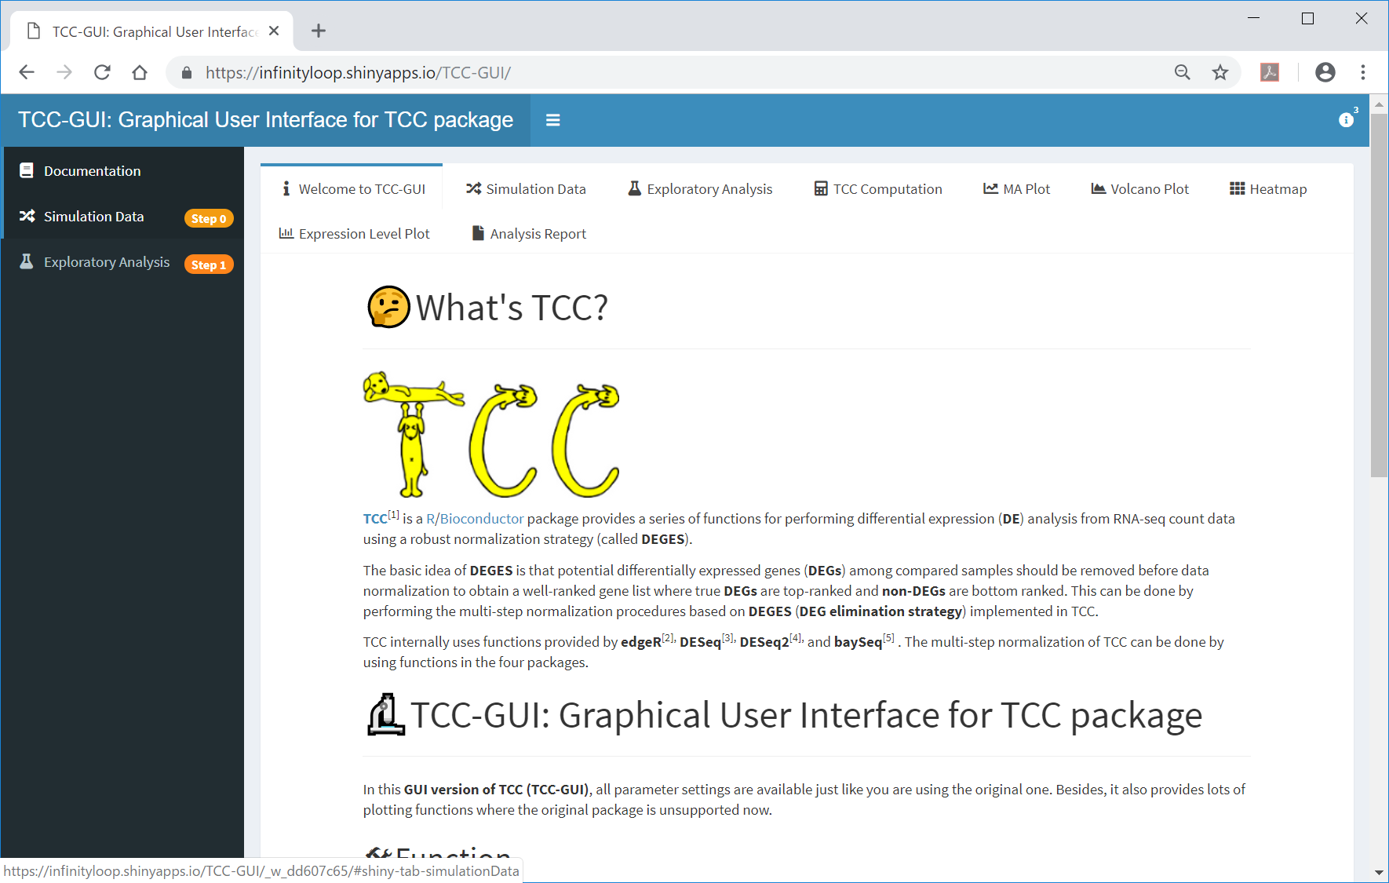
Step 0
①Generation of simulation data can be performed here.
①

Slide 8
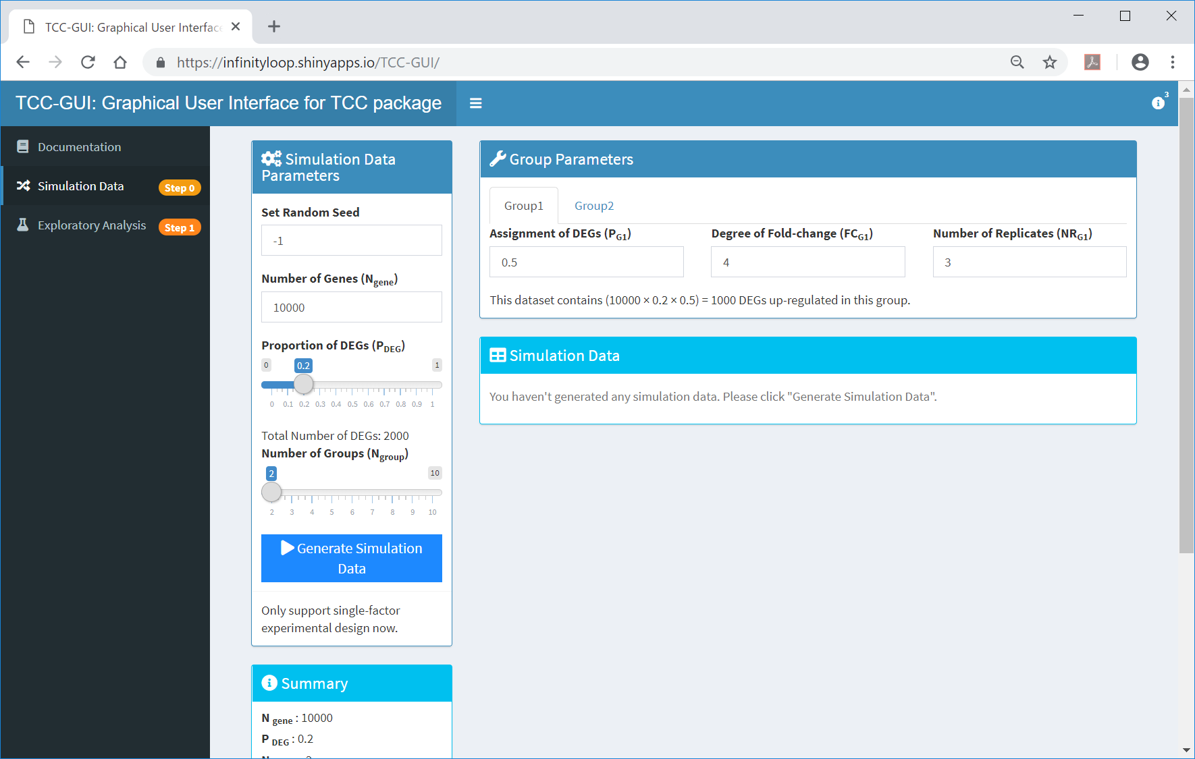
Step 0
The initial screen in Step 0.

Slide 9
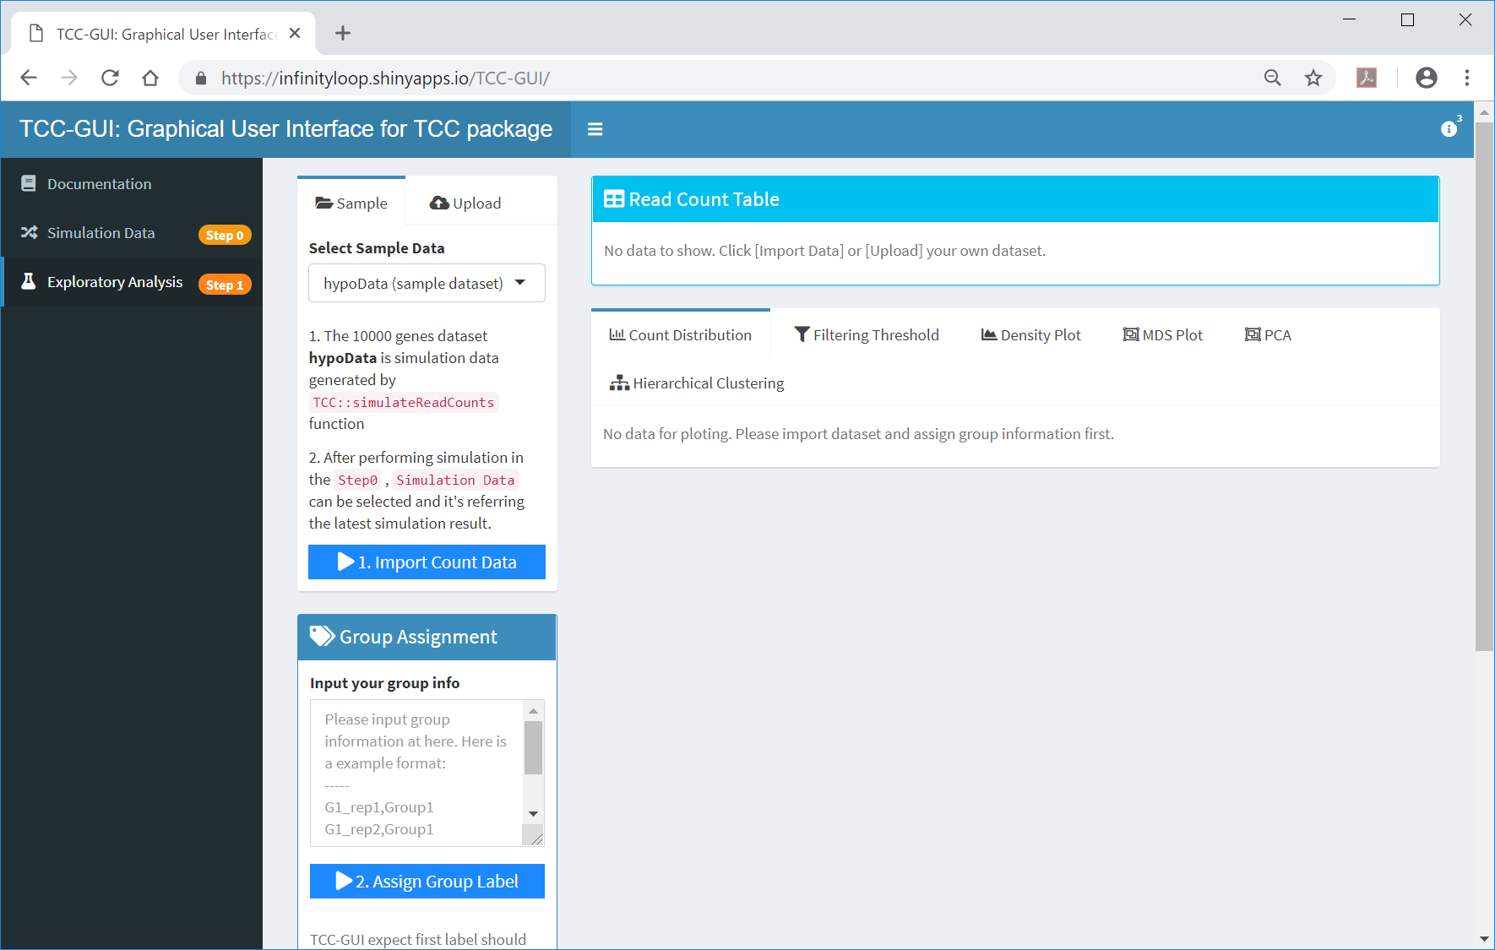
Step 1: initial screen
① Before generating simulation data in Step 0, Step 1 only provides ②hypoData as sample data.
①
②

Slide 10

Re-generation of hypoData
The sample data hypoData can be re-generated by setting ①the seed as 1, ②P_{G1} as ③0.9, and …
②
①
③

Slide 11

Re-generation of hypoData
The sample data hypoData can be re-generated by setting ①the seed as 1, ②P_{G1} as ③0.9, and ④P_{G2} as ⑤0.1
④
⑤

Slide 12
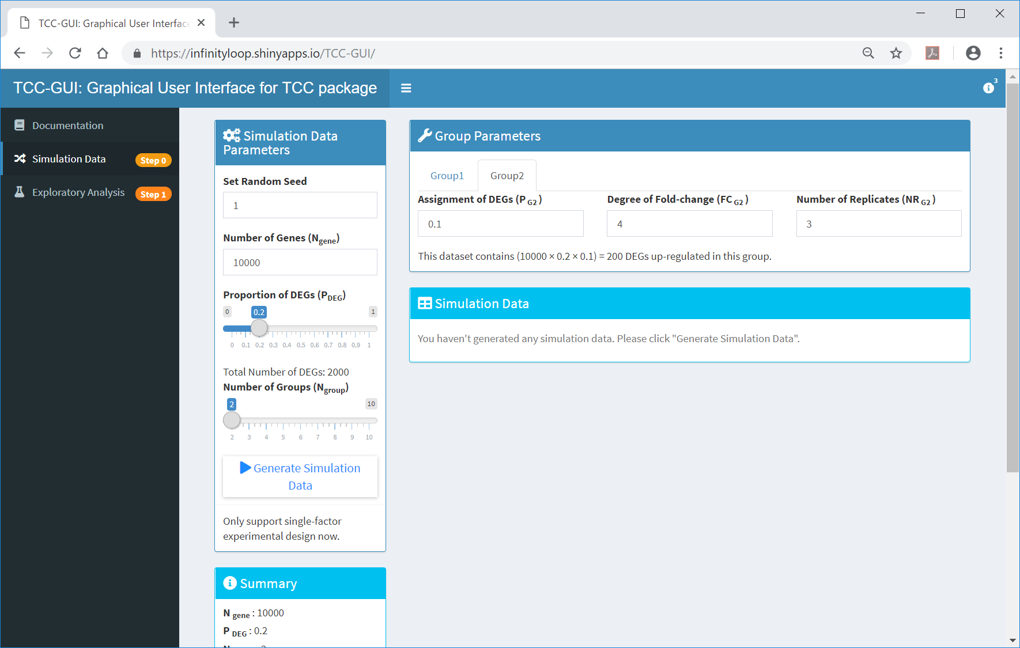
Re-generation of hypoData
①Generate Simulation Data
①

Slide 13
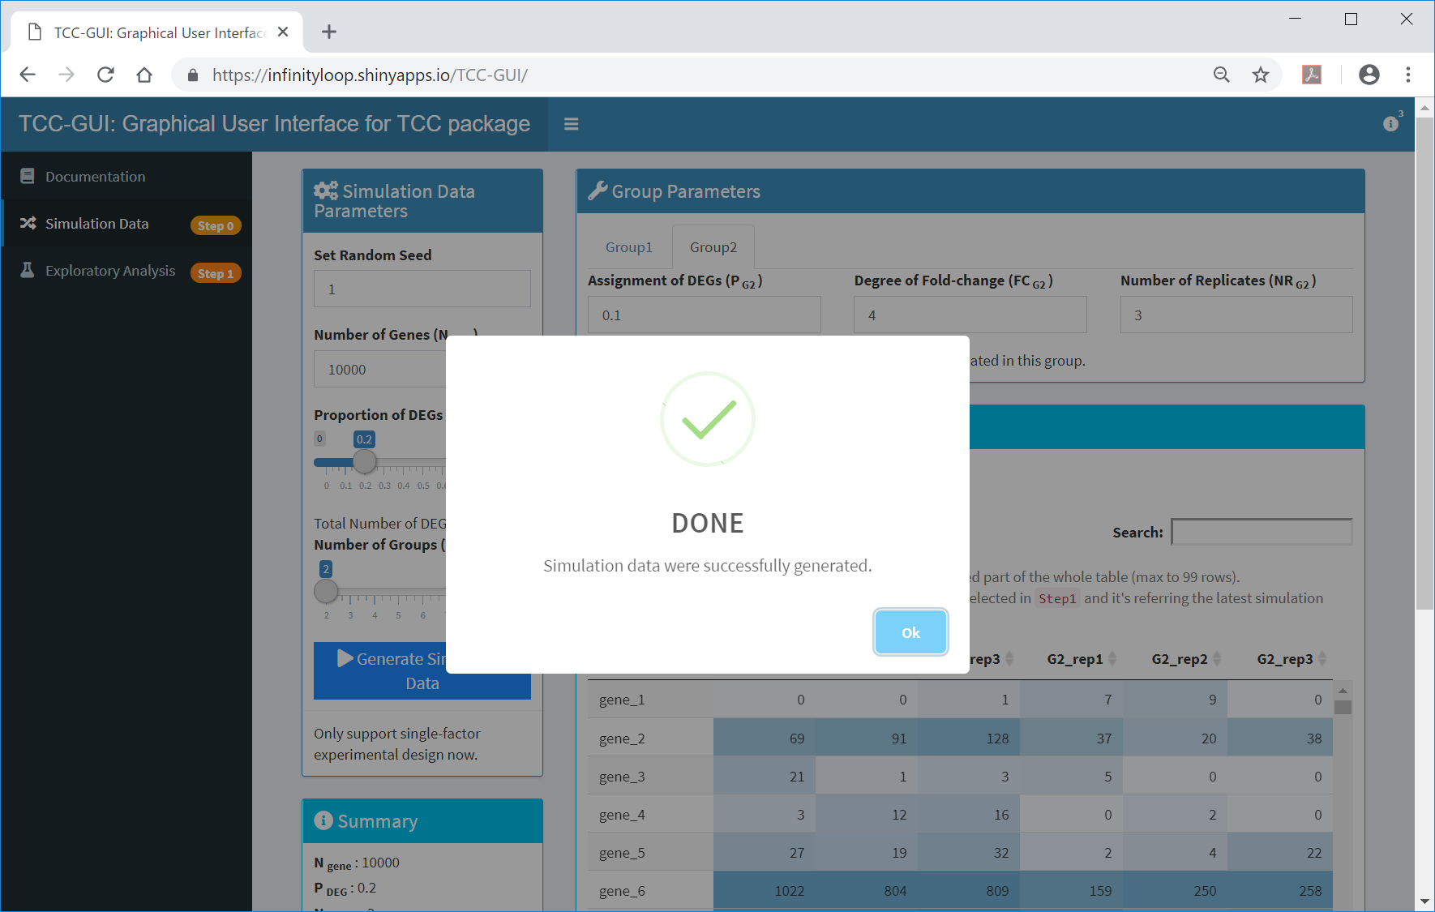
Done
Simulation data were successfully generated.
①

Slide 14
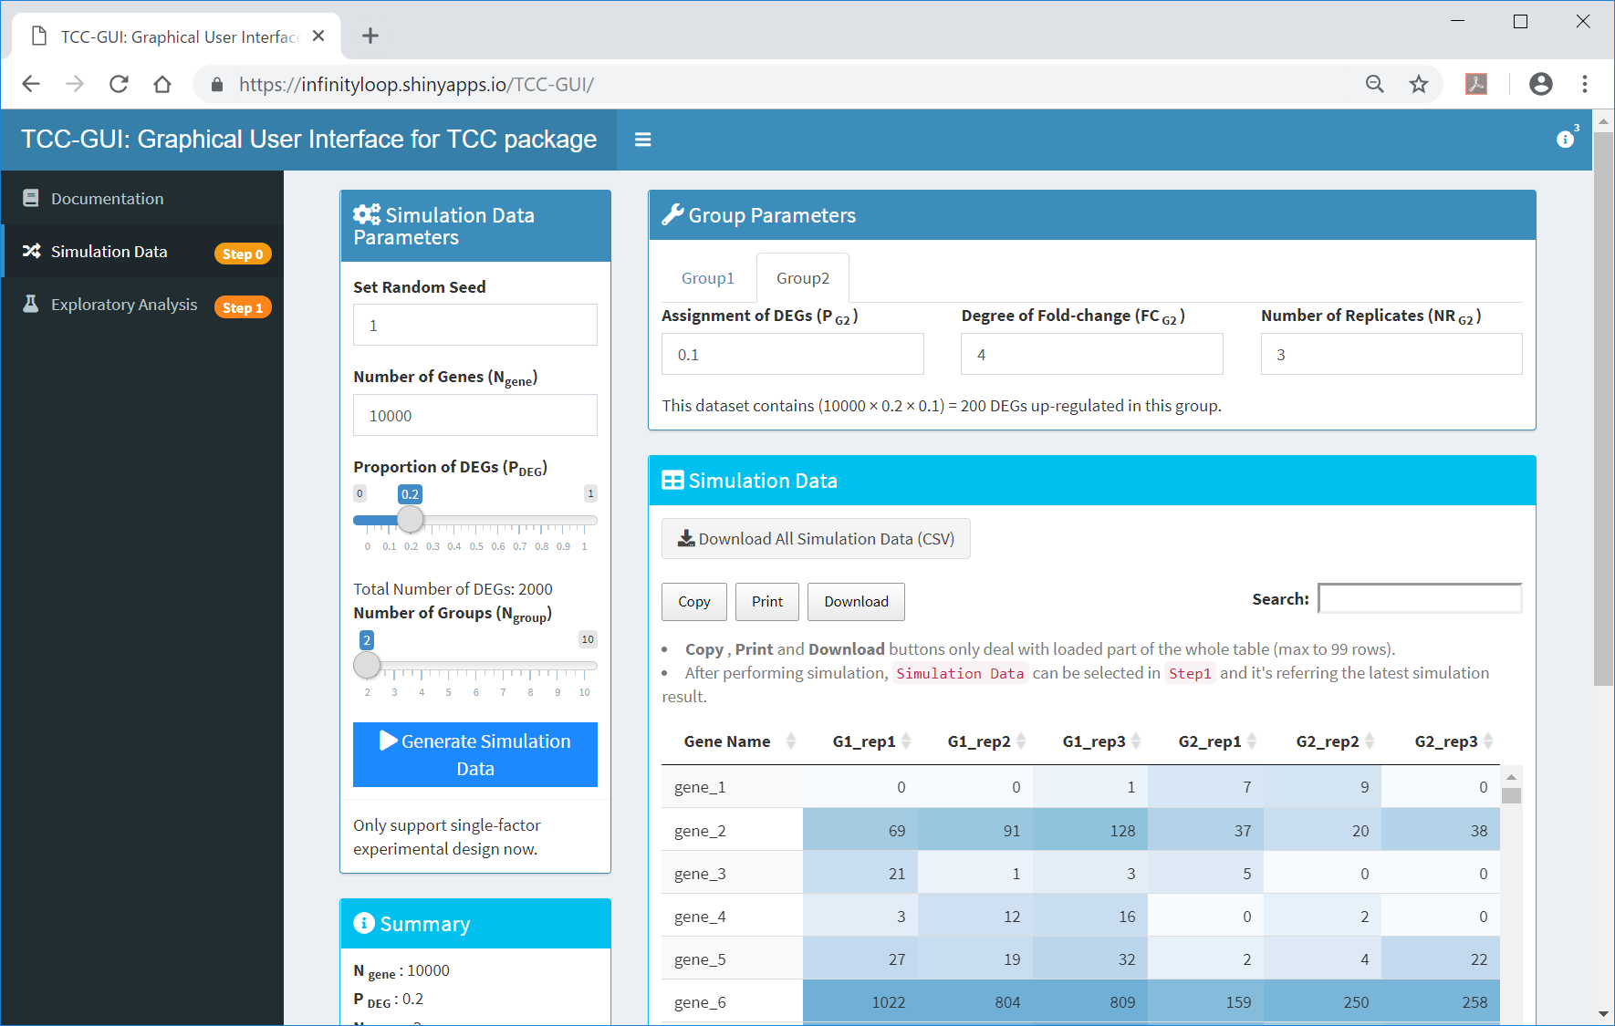
After generation
①The generated data can be downloaded here. ②The summary information can be viewed here.
①
②

Slide 15
Contents
TCC-GUI GitHub page
prerequisites, standalone version, and online version
Data Simulation (Step 0)
Exploratory Analysis (Step 1)
TCC Computation (Step 2)
Visualization (Step 3)
MA Plot, Volcano Plot
Heatmap, Expression Level
Report (Step 4)

Slide 16
Step 1
①The generated data can be used as ②Step 1.
②
①

Slide 17

1. Import Count Data
①The generated data will be selected as the default sample data in Step 1. A simple way to use this data is just push ② and ….
①
②

Slide 18
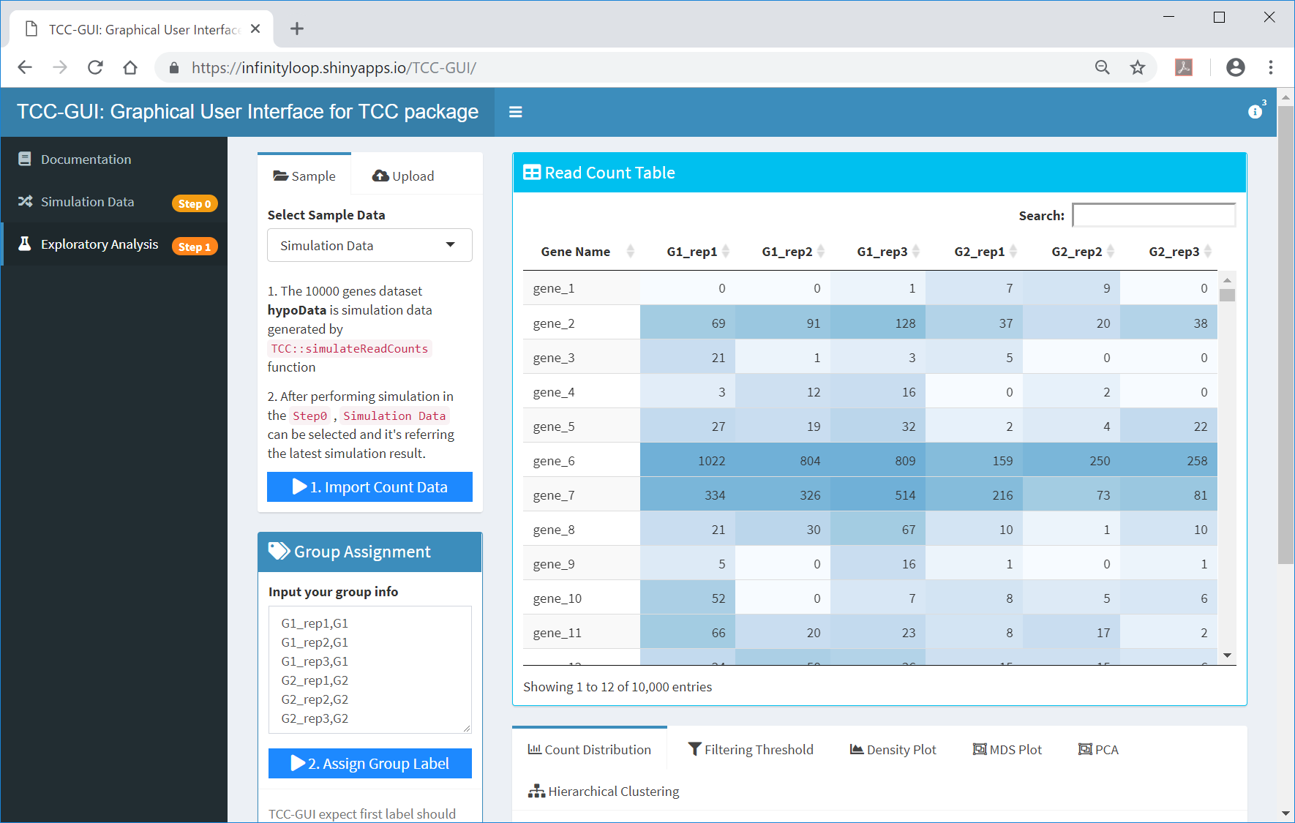
2. Assign Group Label
①The generated data will be selected as the default sample data in Step 1. A simple way to use this data is just push ② and ③.
③

Slide 19
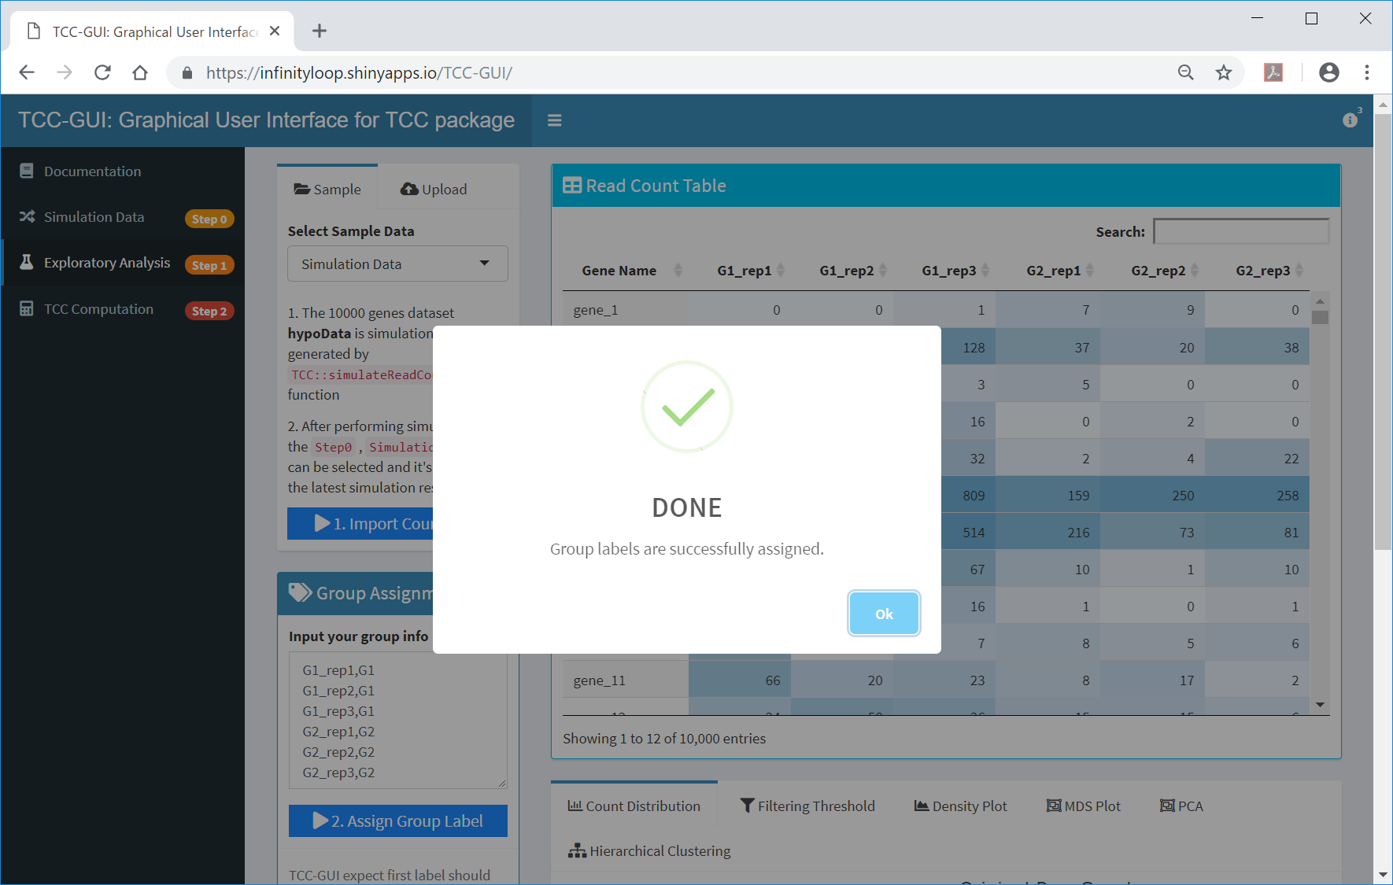
Done
Group labels were successfully assigned. ①ok. ②Move to the bottom of this page.
②
①

Slide 20
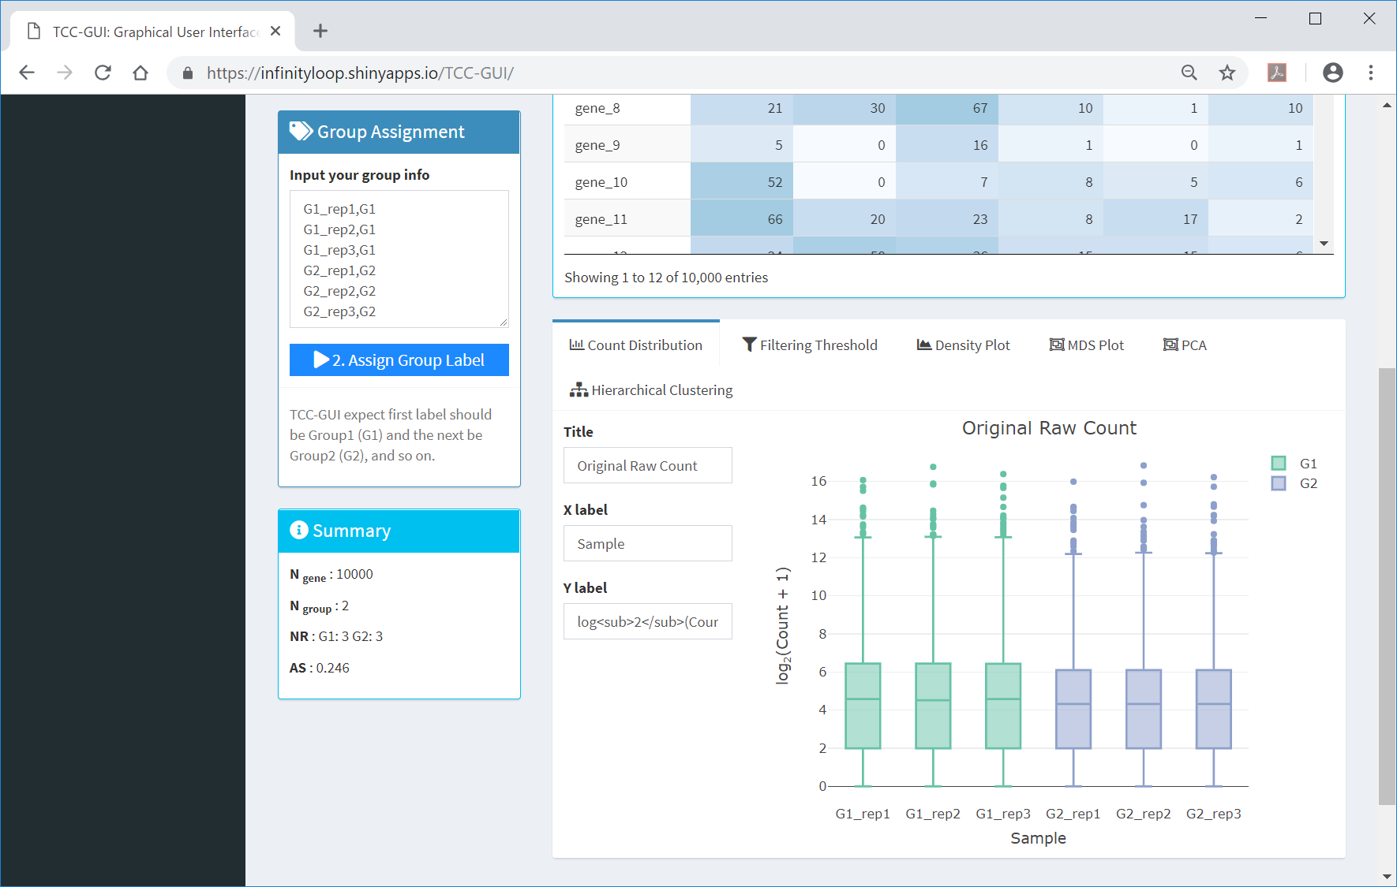
Exploratory Analysis
TCC-GUI provides several tools for exploratory analysis. ①Count Distribution provides box plots for raw counts of individual samples.
①

Slide 21
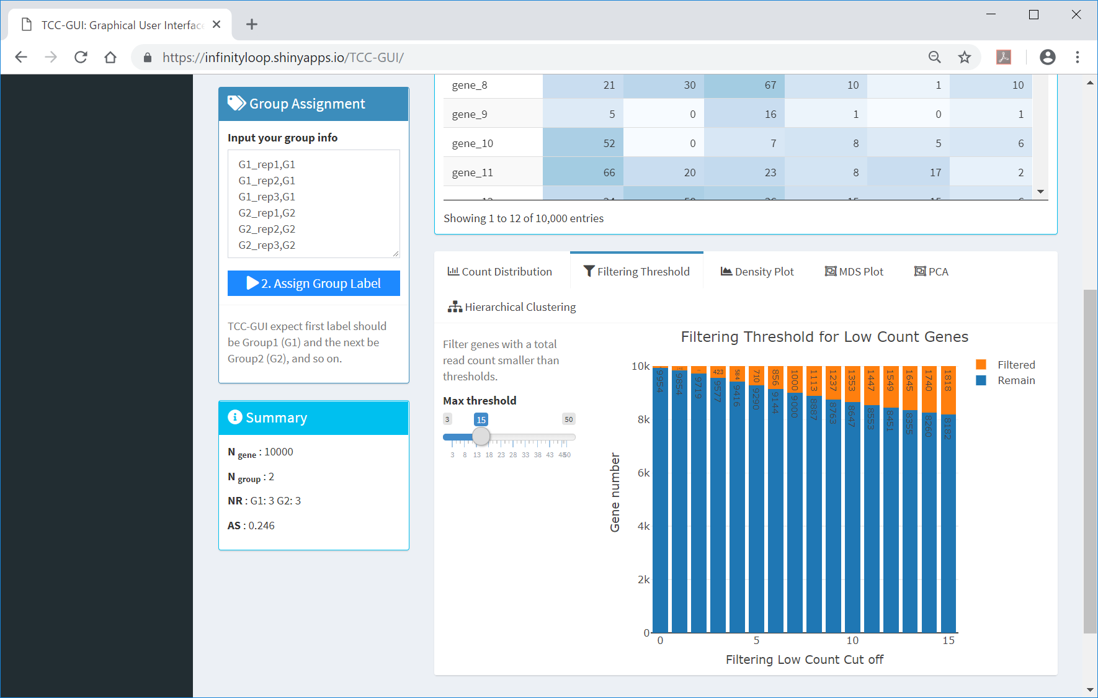
Filtering Threshold
①Filtering Threshold provides the effect of filtering threshold for low count genes. ② The user can change the max threshold,
①
②

Slide 22
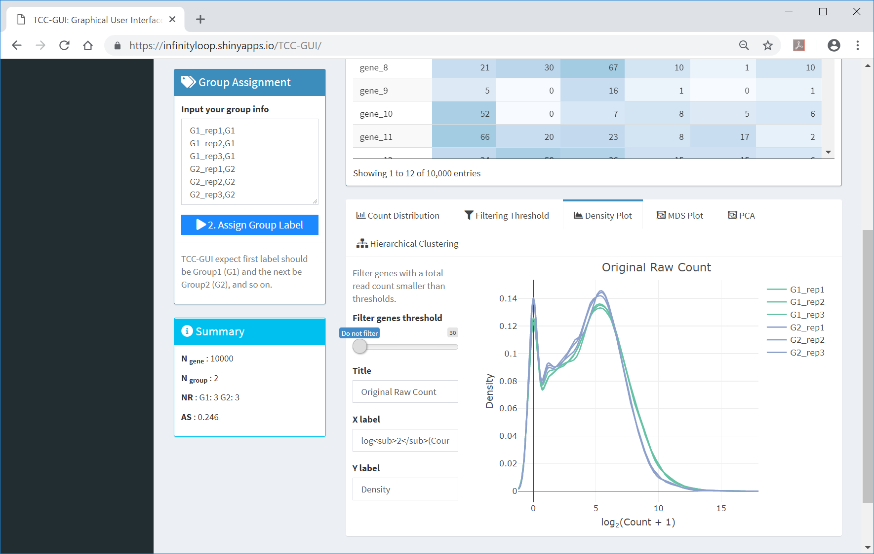
Density Plot
Similar to Count Distribution, ①Density Plot provides density plots for raw counts of individual samples. ②By changing the threshold to filter low count genes, the user can see the change of the plot in real-time.
①
②

Slide 23

Density Plot
Similar to Count Distribution, ①Density Plot provides density plots for raw counts of individual samples. ②By changing the threshold to filter low count genes, the user can see the change of the plot in real-time.
①
②

Slide 24
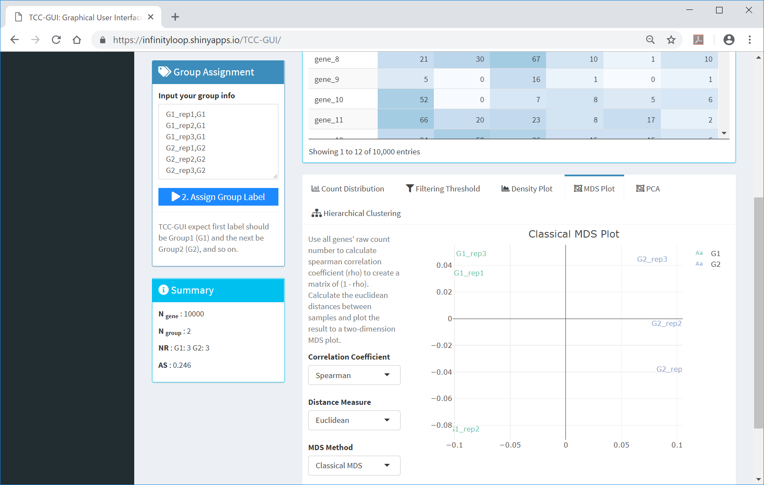
MDS Plot
①MDS Plot provides the result of multi-dimensional scaling (MDS).
①

Slide 25
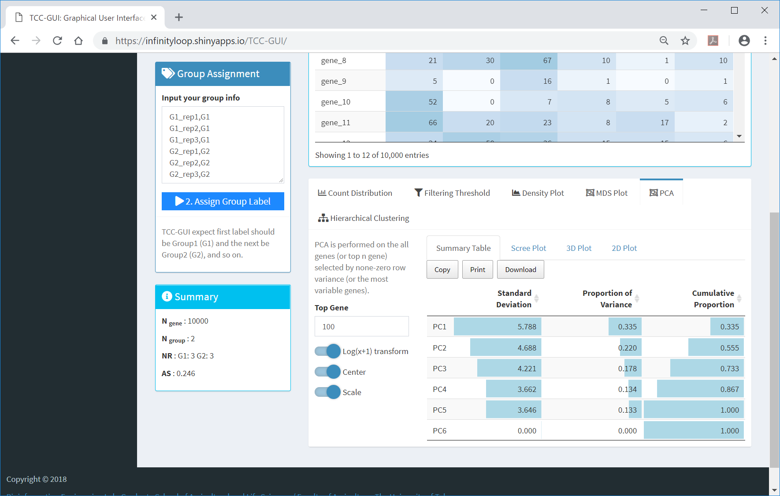
PCA
①In PCA, the user can see the ②Summary Table, ③Scree Plot, ④3D Plot, and ⑤2D Plot.
①
②
③
④
⑤

Slide 26
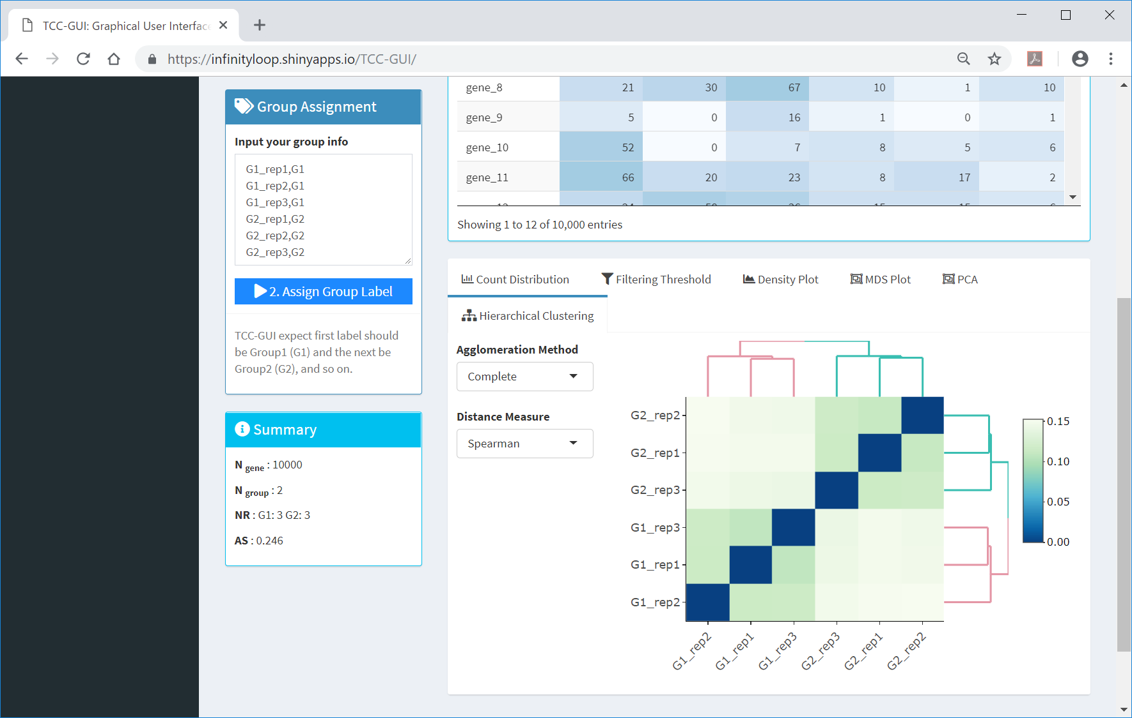
Hierarchical Clustering
①In Hierarchical Clustering, the user can see the result (②dendrogram) of sample clustering. As expected by the nature of this simulation data (20% of genes are DEG; P_{DEG} = 0.2), a higher degree of group separation can be seen.
①
②

Slide 27
Average Silhouettes (AS)
Although the evaluation of ①the dendrogram is subjective, ②the average silhouettes (AS) score provides an objective measure for estimating the degree of group separation (Zhao et al.. 2018). It ranges from 1.0 to − 1.0, and a higher AS value indicates a higher degree of group separation (i.e., a higher percentage of DEG).
①
②
Zhao et al., Biol. Proced. Online, 20:5, 2018

Slide 28
Contents
TCC-GUI GitHub page
prerequisites, standalone version, and online version
Data Simulation (Step 0)
Exploratory Analysis (Step 1)
TCC Computation (Step 2)
Visualization (Step 3)
MA Plot, Volcano Plot
Heatmap, Expression Level
Report (Step 4)

Slide 29

Step 2
①TCC Computation (Step 2) can be performed just after finishing ②the assignment of group label in Step 1.
①
②

Slide 30
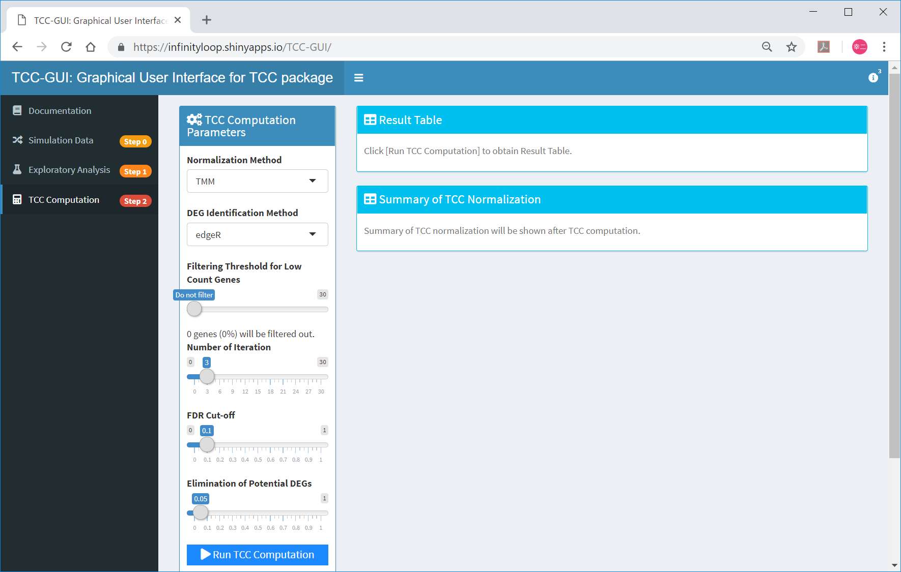
Run TCC Computation
①Although several options are provided in the parameter setting panel, a simple way to perform DE analysis with TCC is just push ②Run TCC Computation.
①
②

Slide 31
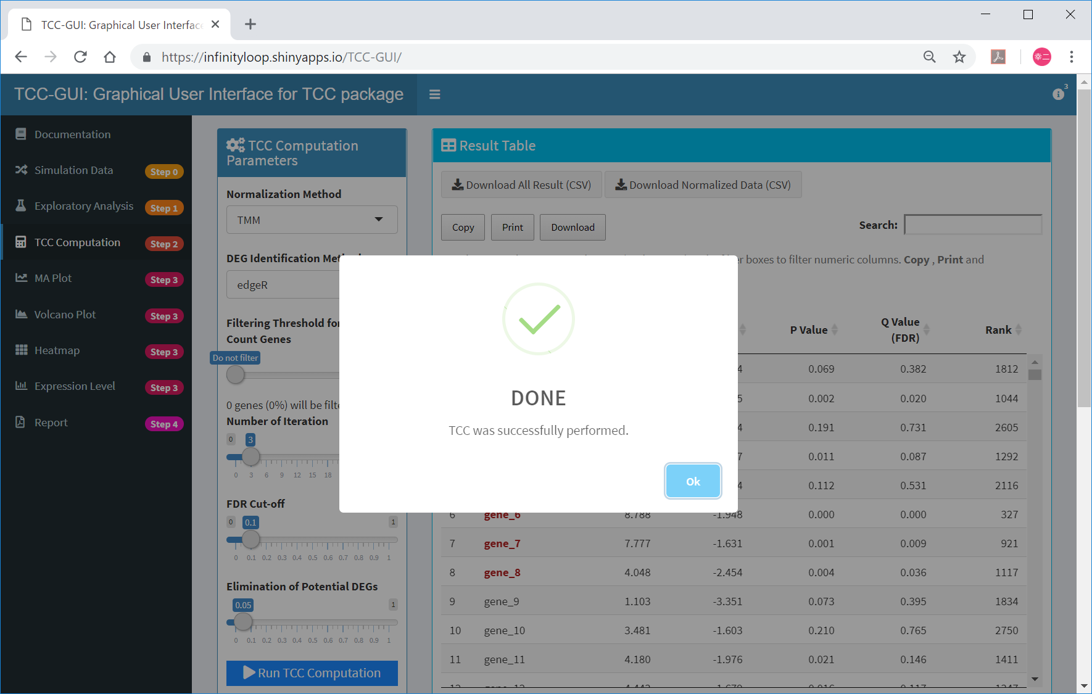
Done
TCC was successfully performed.

Slide 32
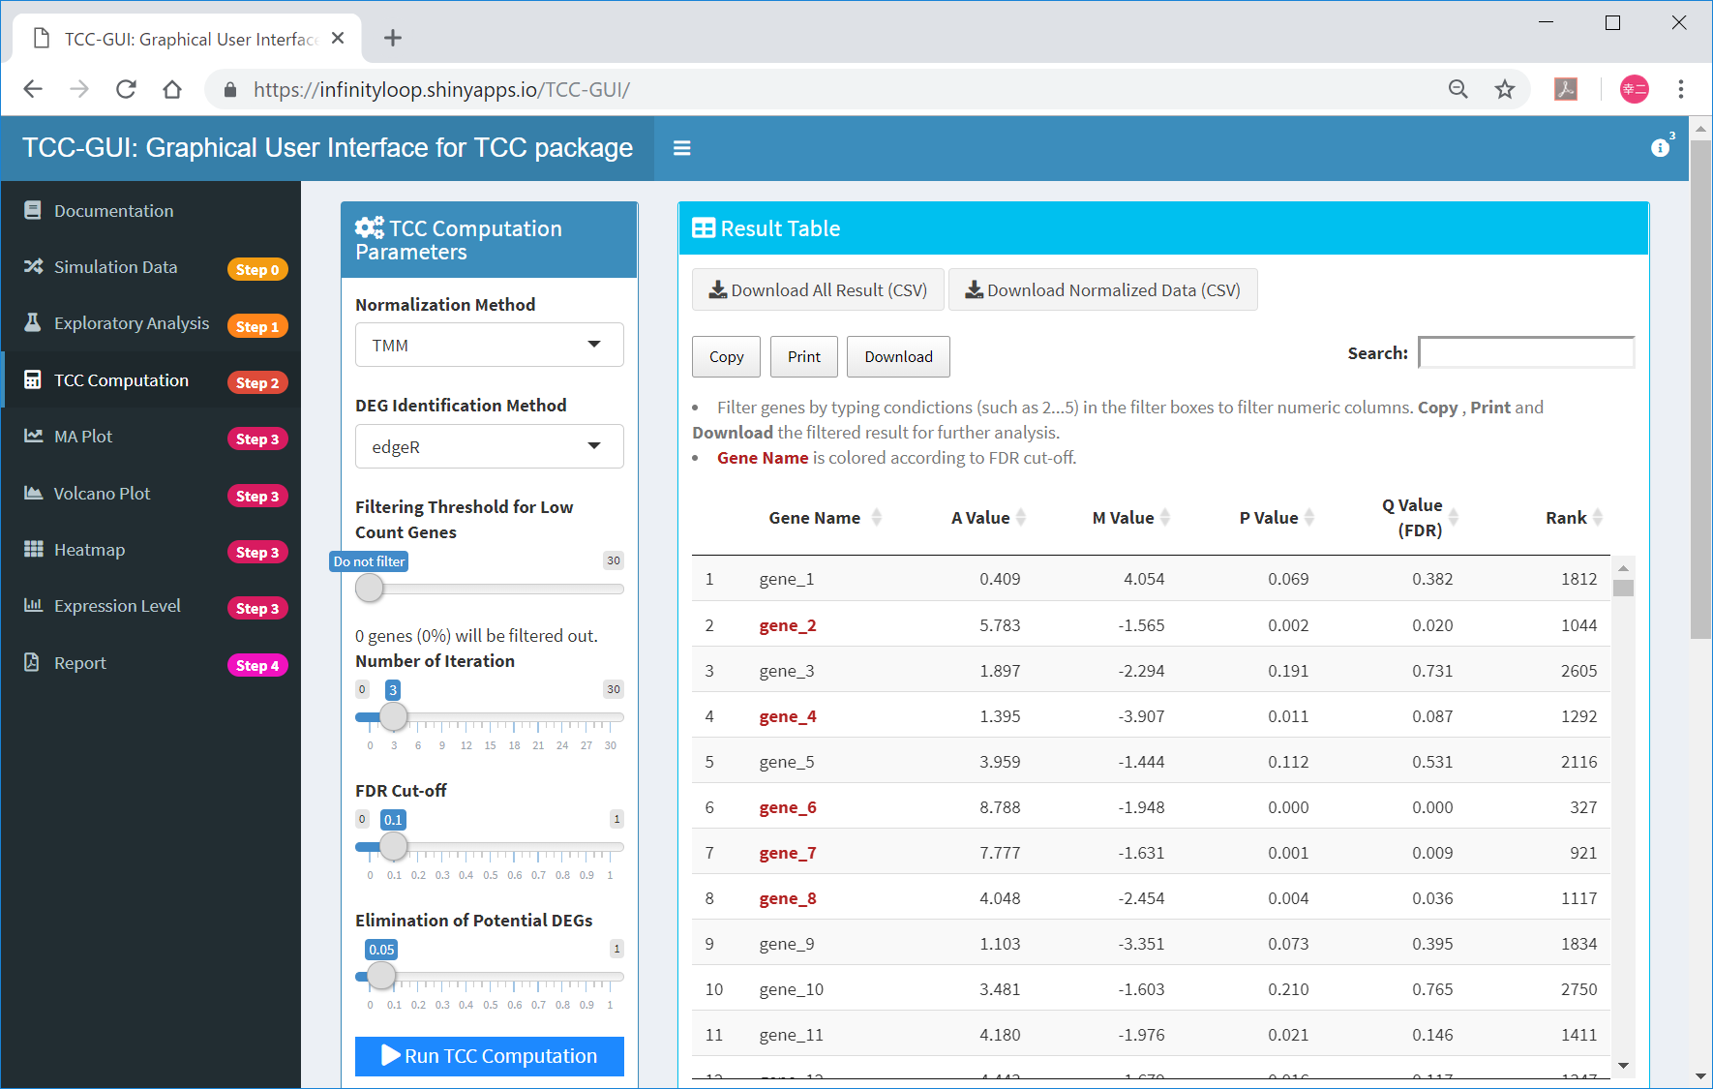
Step 2 finished
The user can download ①the DE result and ②TCC-normalized data. ③ the remaining steps are therefore optional.
①
②
③

Slide 33
Step 2 finished
①Genes satisfying ②10% FDR (i.e., ③Q-value < 0.1) are colored in red.
②
①
③

Slide 34
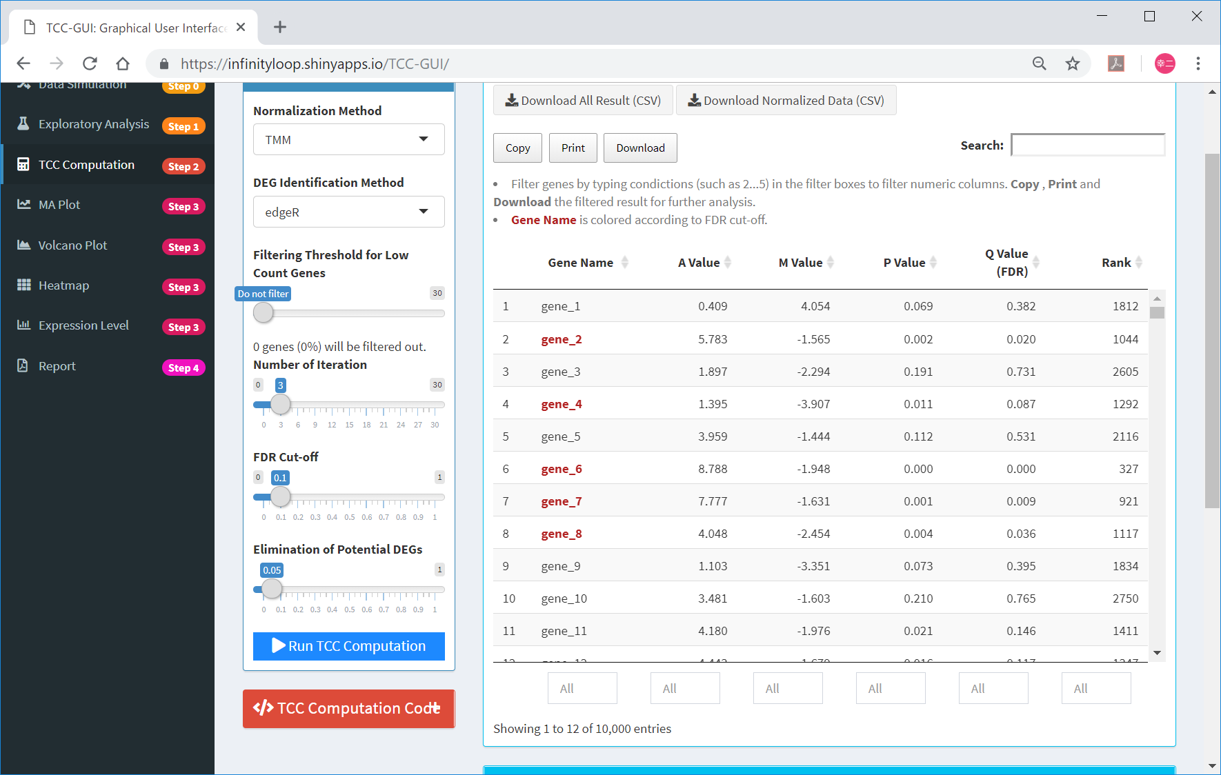
Filtering
①The boxes at the bottom of the Result Table panel can be used to filter genes by the column of interest.
①

Slide 35
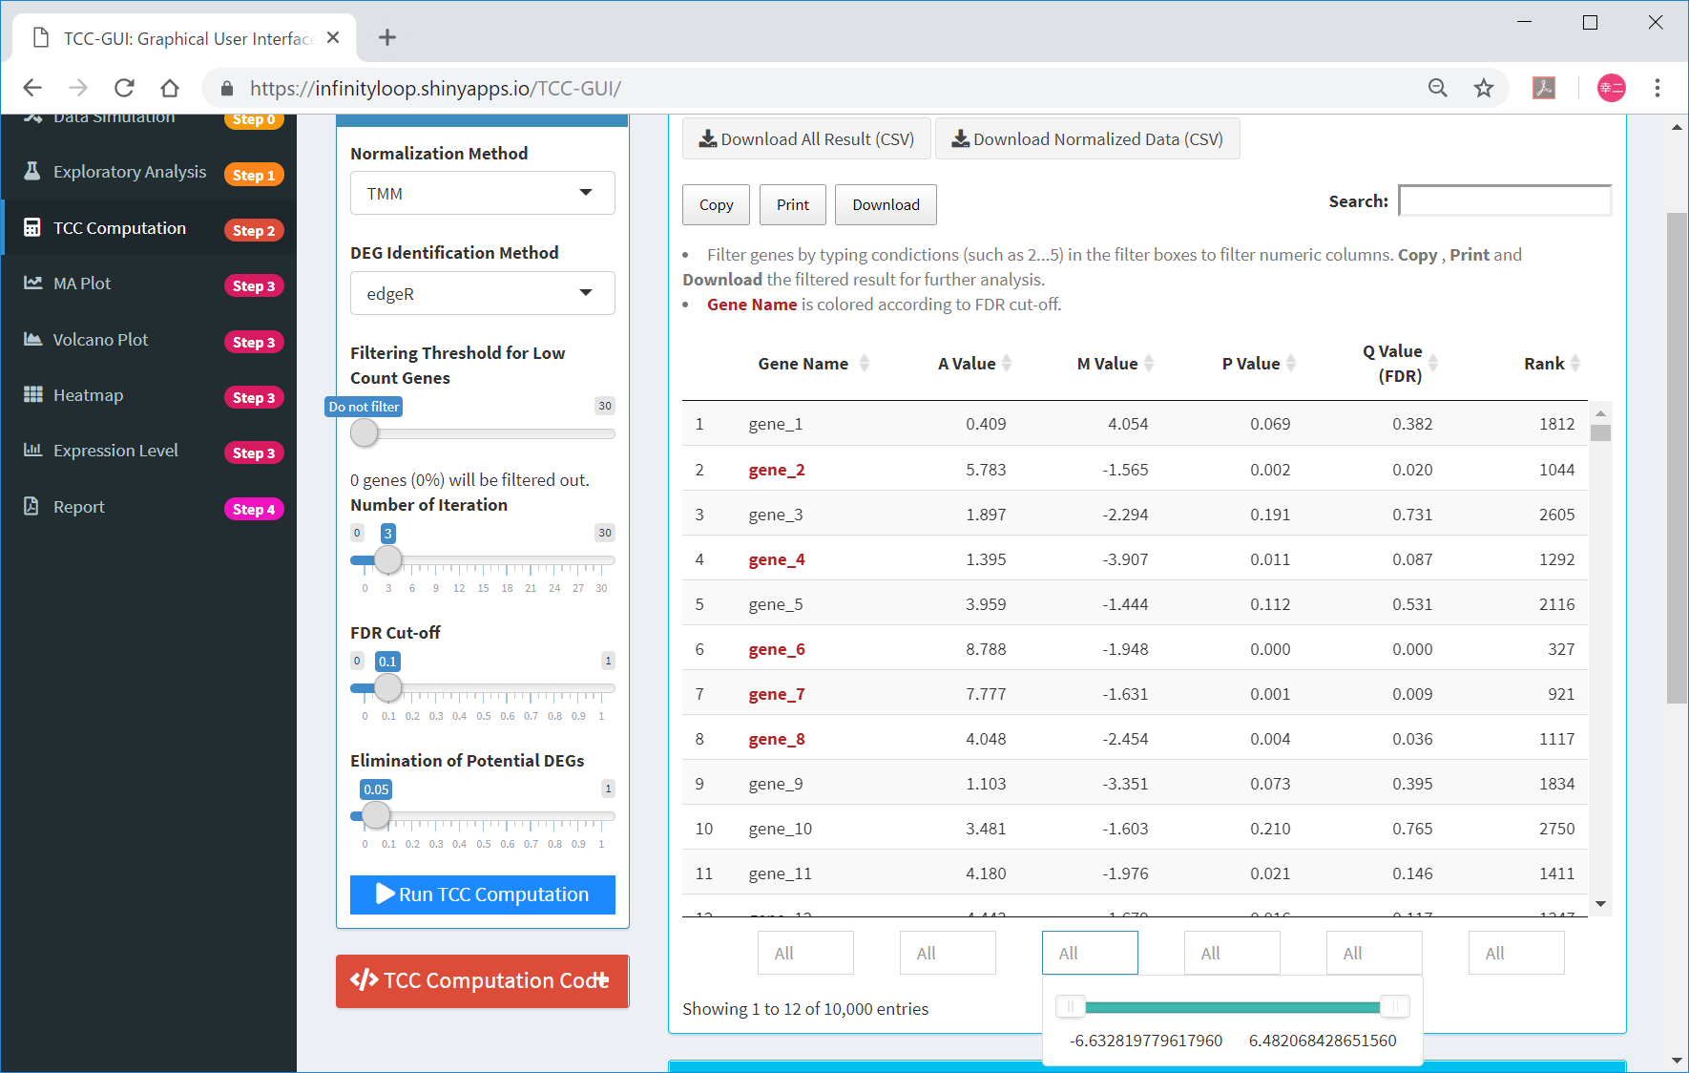
Filtering
For example, ①the user can see the range of M Value (i.e., log-ratios). In the case of “hypoData”, the user can see the range as [-6.63, 6.48].
①

Slide 36

Filtering
①The user can filter genes having M values within the range [0.52, 6.48] as follows.
①

Slide 37

Filtering
Otherwise, the user may indicate the range of interest directly as ①“1.0...7.0” in the box. ②The user will see the number of genes satisfying the range.
①
②

Slide 38

R code
①TCC-GUI provides R codes internally used to execute the TCC.
①

Slide 39
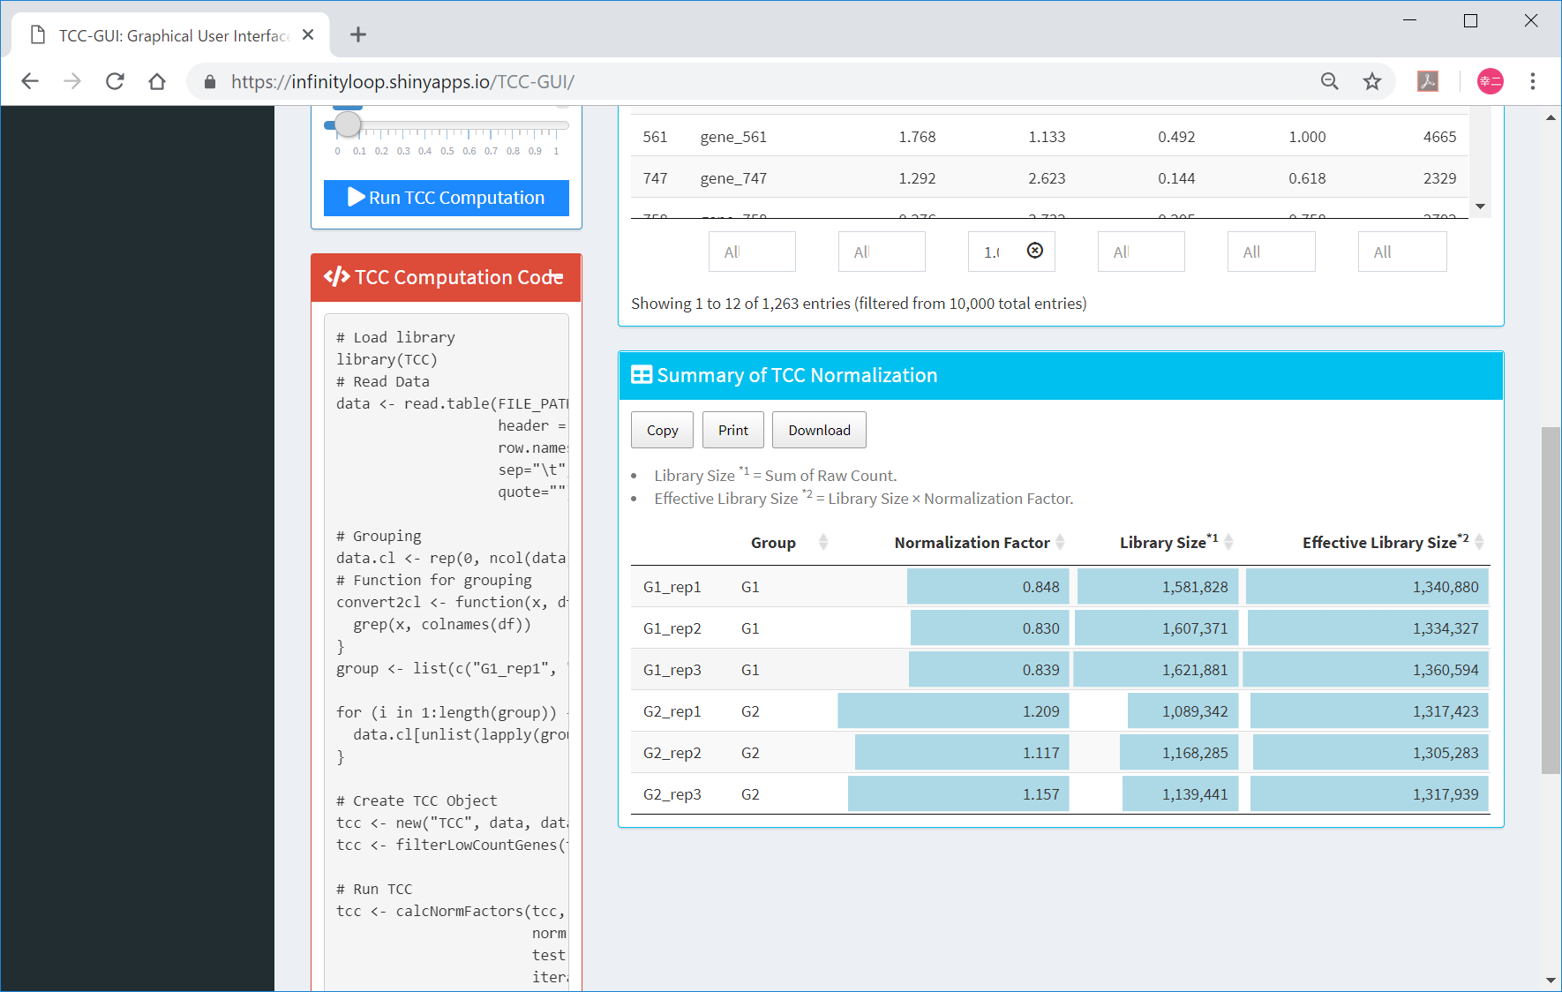
R code
①TCC-GUI provides R codes internally used to execute the TCC.

Slide 40
Contents
TCC-GUI GitHub page
prerequisites, standalone version, and online version
Data Simulation (Step 0)
Exploratory Analysis (Step 1)
TCC Computation (Step 2)
Visualization (Step 3)
MA Plot, Volcano Plot
Heatmap, Expression Level
Report (Step 4)

Slide 41

Step 3
①MA plot can be generated here.
①

Slide 42
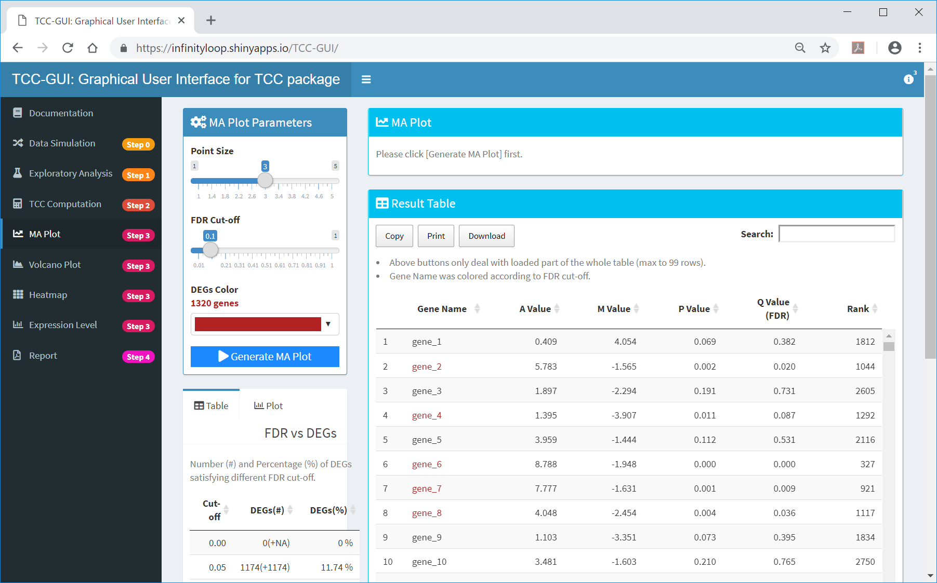
MA Plot
①Generate MA Plot
①

Slide 43
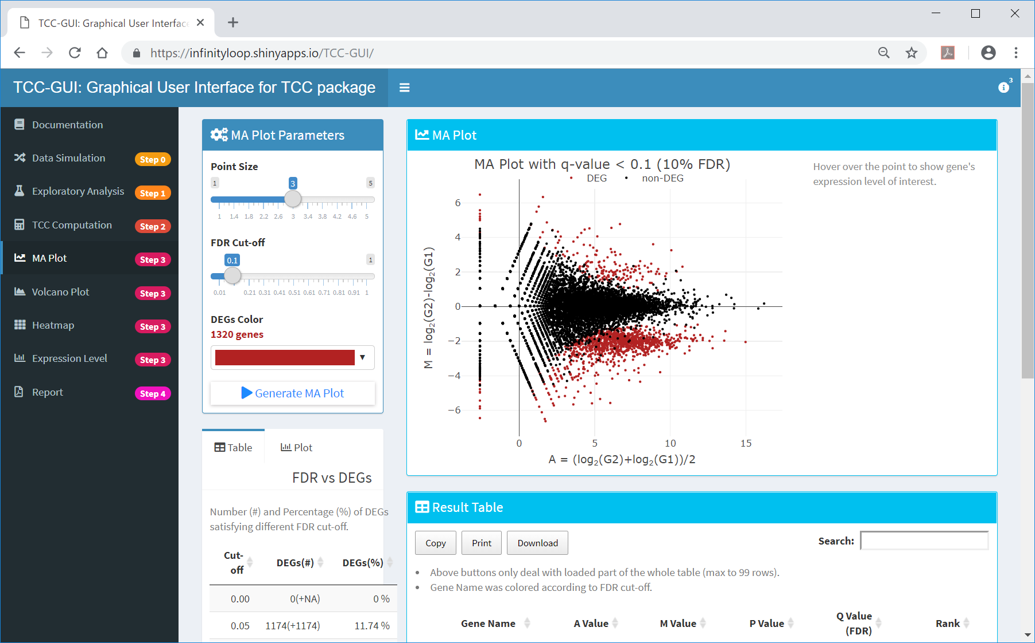
MA Plot generated
By default, genes satisfying ①10% FDR are colored in ②dark red.
①
②

Slide 44
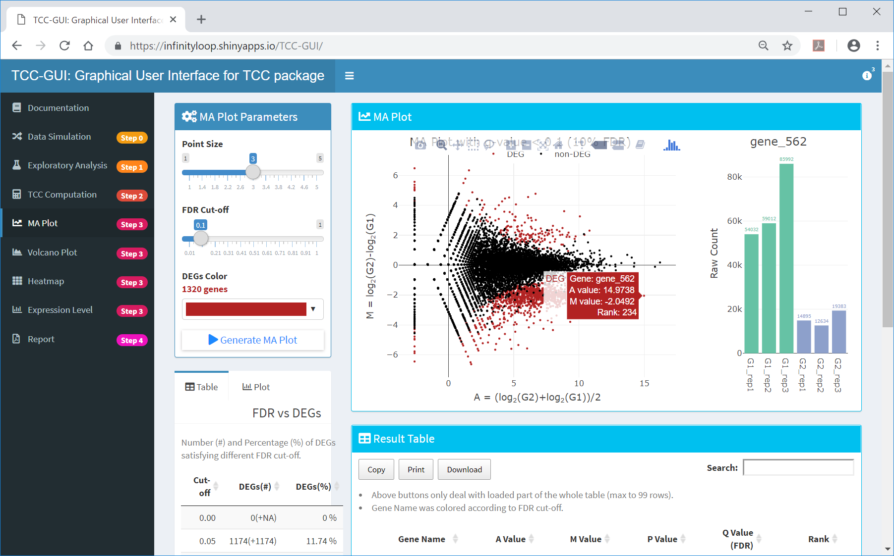
Detailed information
the user can obtain more detailed information about the gene of interest (e.g., “gene_562”) by pointing the cursor in ①that location.
①

Slide 45
Number of genes satisfying…
①The number of genes satisfying ②various FDR thresholds can be seen in real time.
②
①

Slide 46
FDR vs DEGs
①The number of genes satisfying various FDR cut-offs in increments of 0.05 in tabular form is also provided. These information as well as the AS value would be helpful to estimate how true DEGs are included in the input data.
①

Slide 47
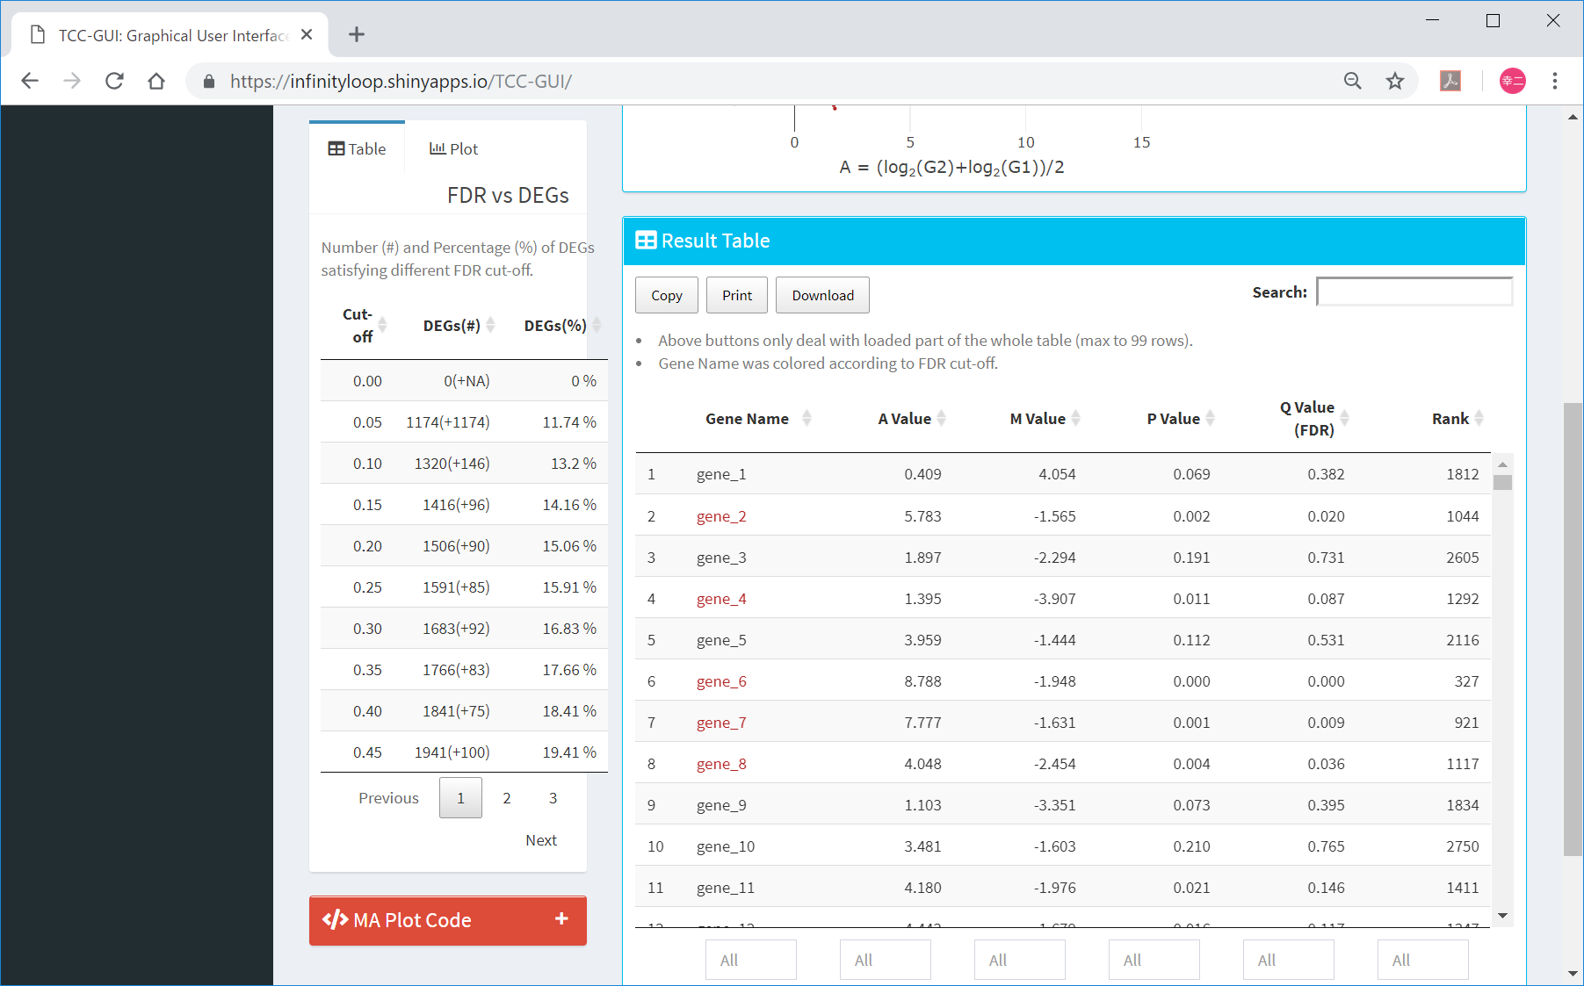
FDR vs DEGs
①The number of genes satisfying various FDR cut-offs in increments of 0.05 in tabular form is also provided. These information as well as the AS value would be helpful to estimate how true DEGs are included in the input data.
①

Slide 48
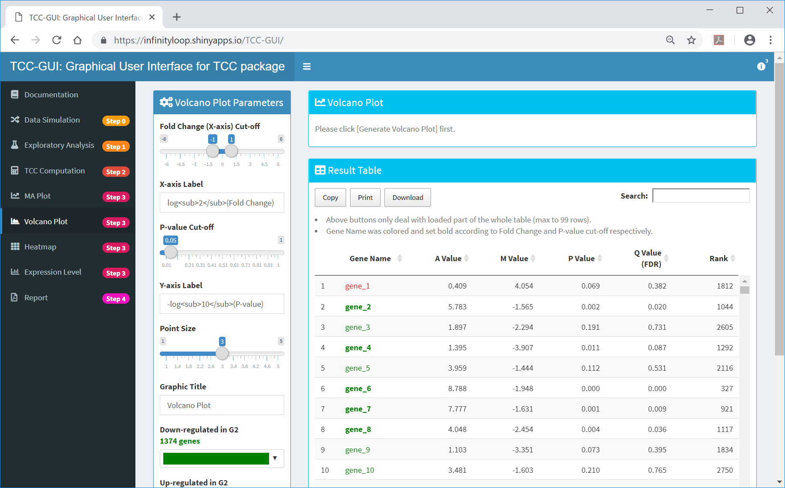
Volcano Plot
①Volcano Plot can also be performed.
①

Slide 49
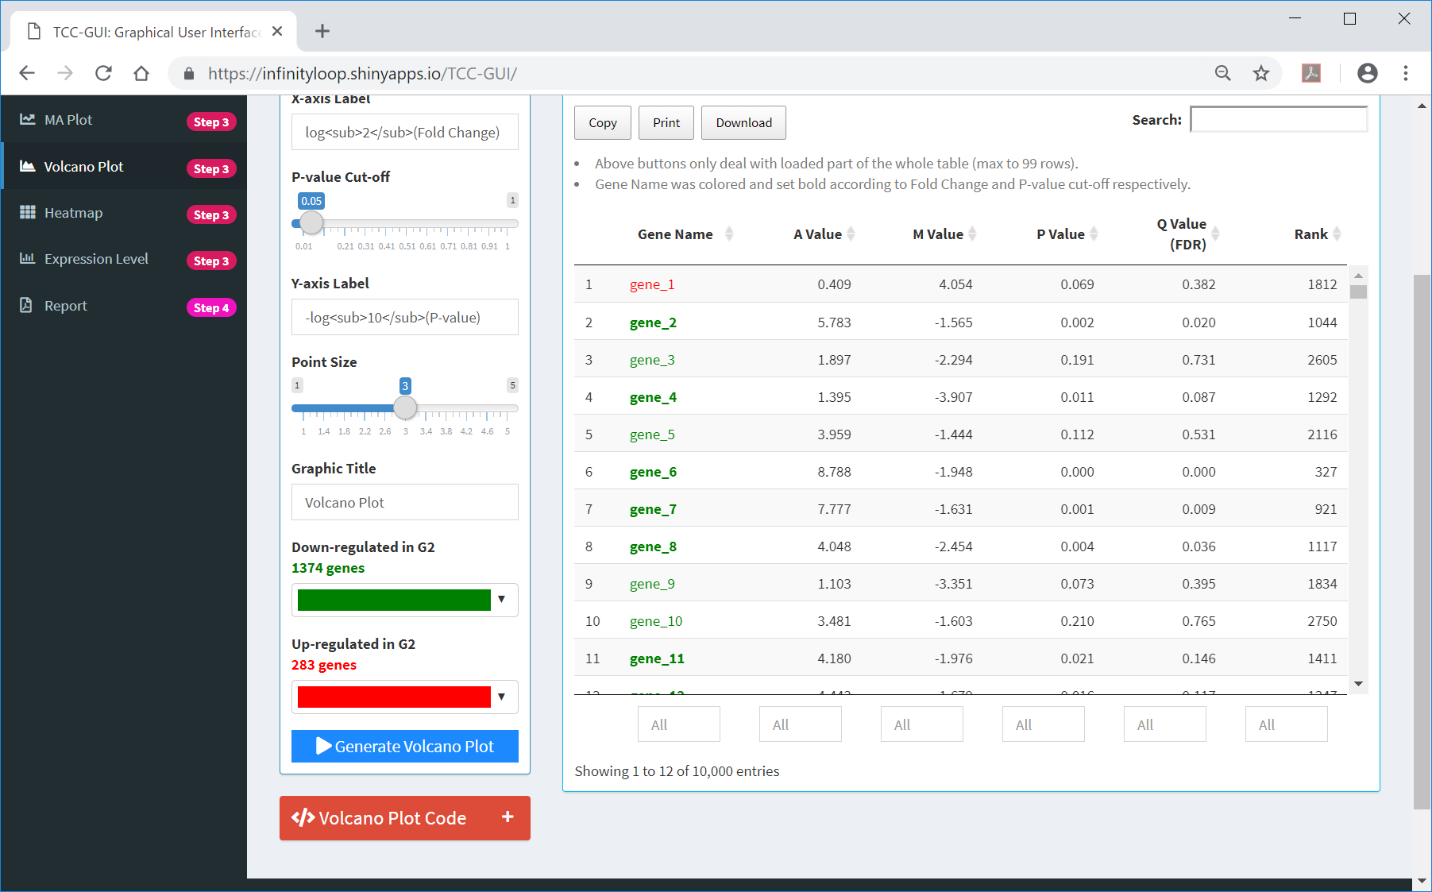
Volcano Plot
①To generate the volcano plot, click here.
①

Slide 50
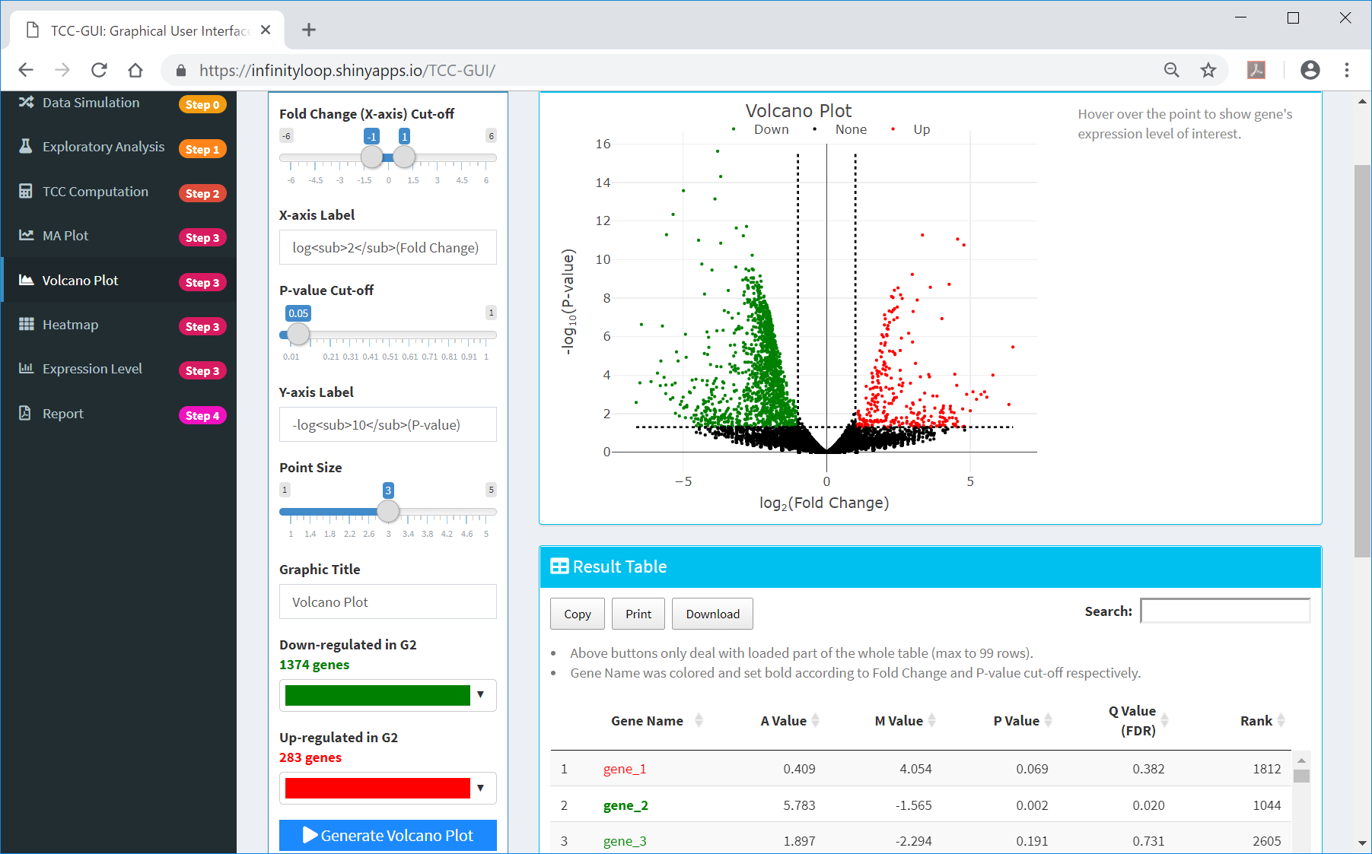
Volcano Plot generated
①A volcano plot was generated. In case of the result for hypoData with default settings, ②the user will see 1,374 genes down-regulated and 283 genes up-regulated in G2. This is reasonable because the hypoData contains 1,800 genes down-regulated and 200 genes up-regulated in G2.
①
②

Slide 51
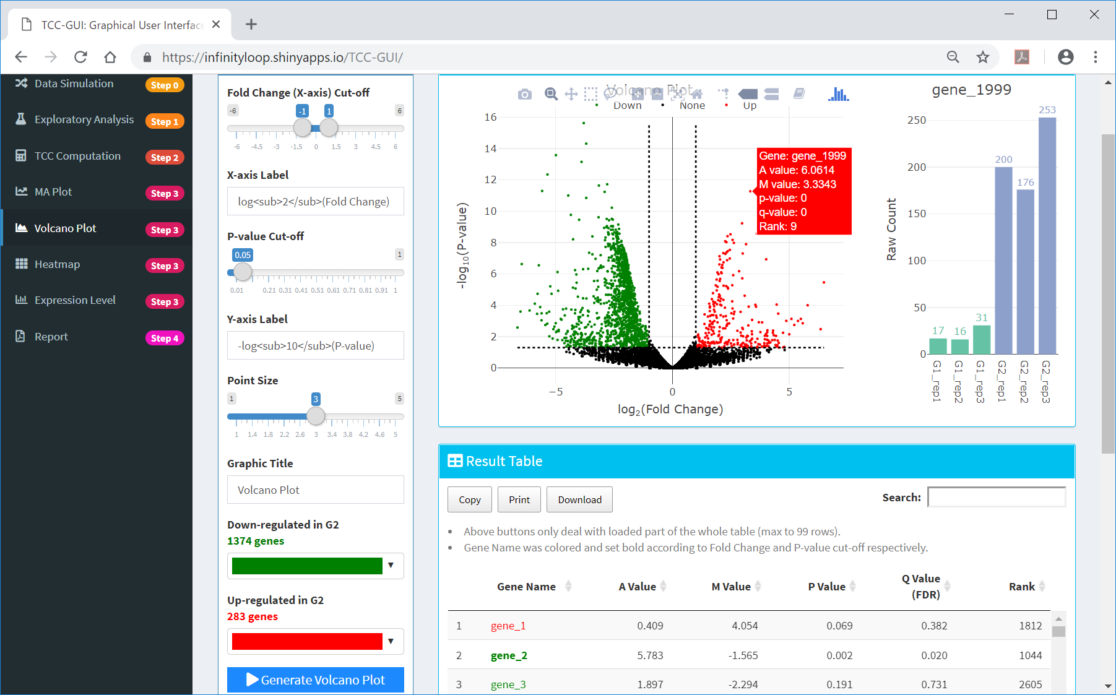
Detailed information
the user can obtain more detailed information about the gene of interest (e.g., “gene_1999”) by pointing the cursor in ①that location.
①

Slide 52
Contents
TCC-GUI GitHub page
prerequisites, standalone version, and online version
Data Simulation (Step 0)
Exploratory Analysis (Step 1)
TCC Computation (Step 2)
Visualization (Step 3)
MA Plot, Volcano Plot
Heatmap, Expression Level
Report (Step 4)

Slide 53
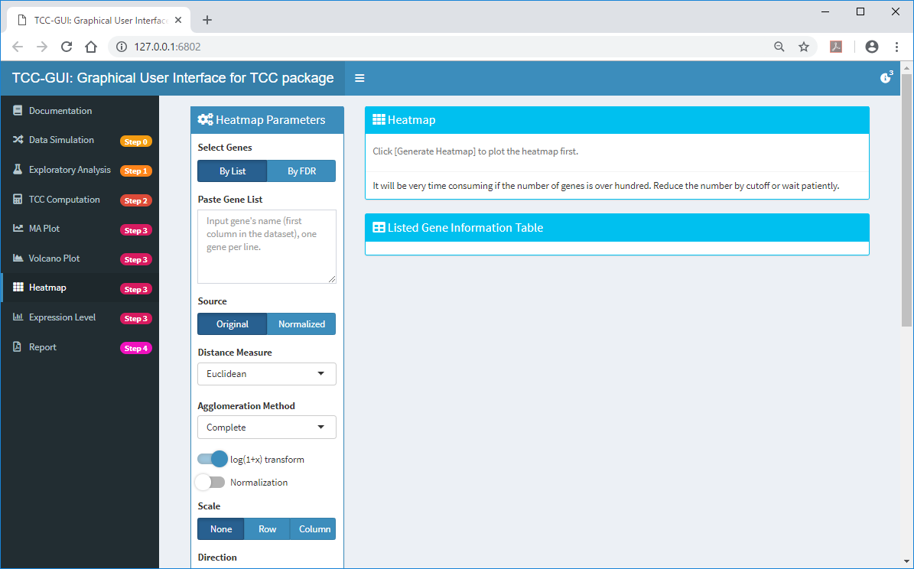
Heatmap
①Heatmap is a graphical representation of data where the individual count values contained in a matrix are represented as pseudo-colors.
①

Slide 54
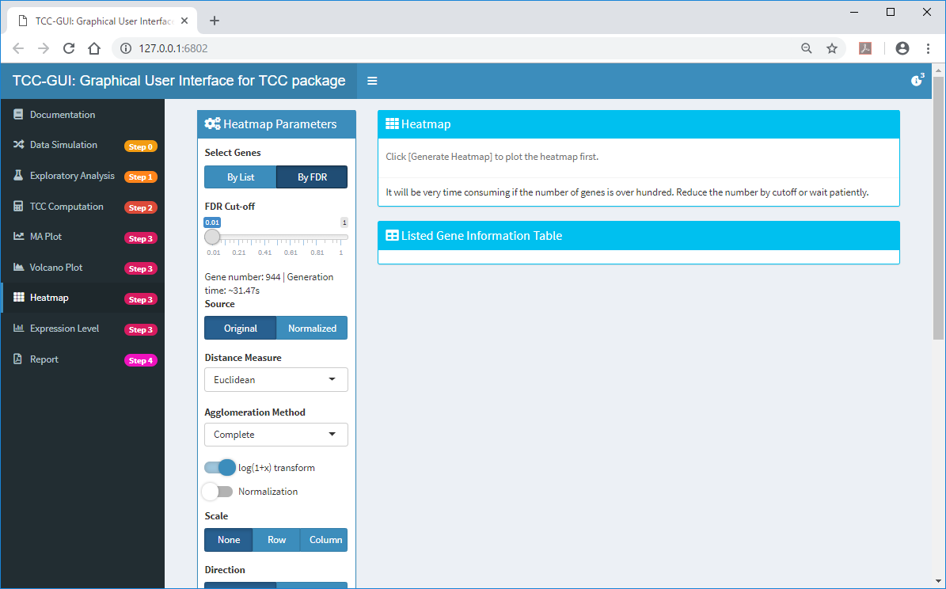
Heatmap
①Users can generate heatmap for genes satisfying arbitrary defined FDR cut-off. We here use 944 genes satisfying ③1% FDR cut-off.
①
③
②

Slide 55
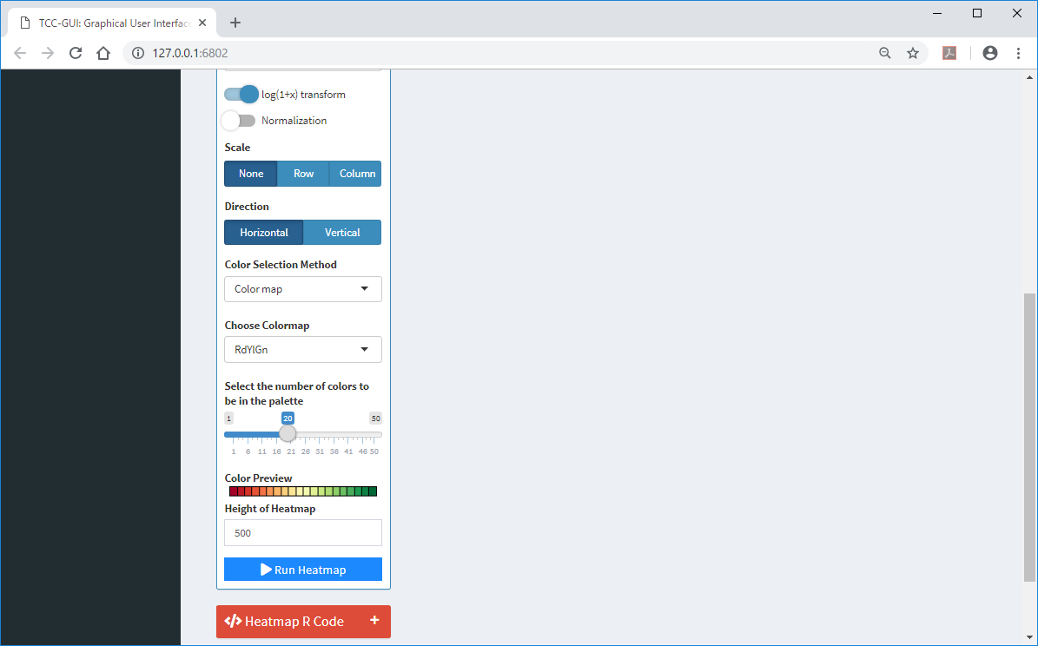
Heatmap
①Run Heatmap
①

Slide 56
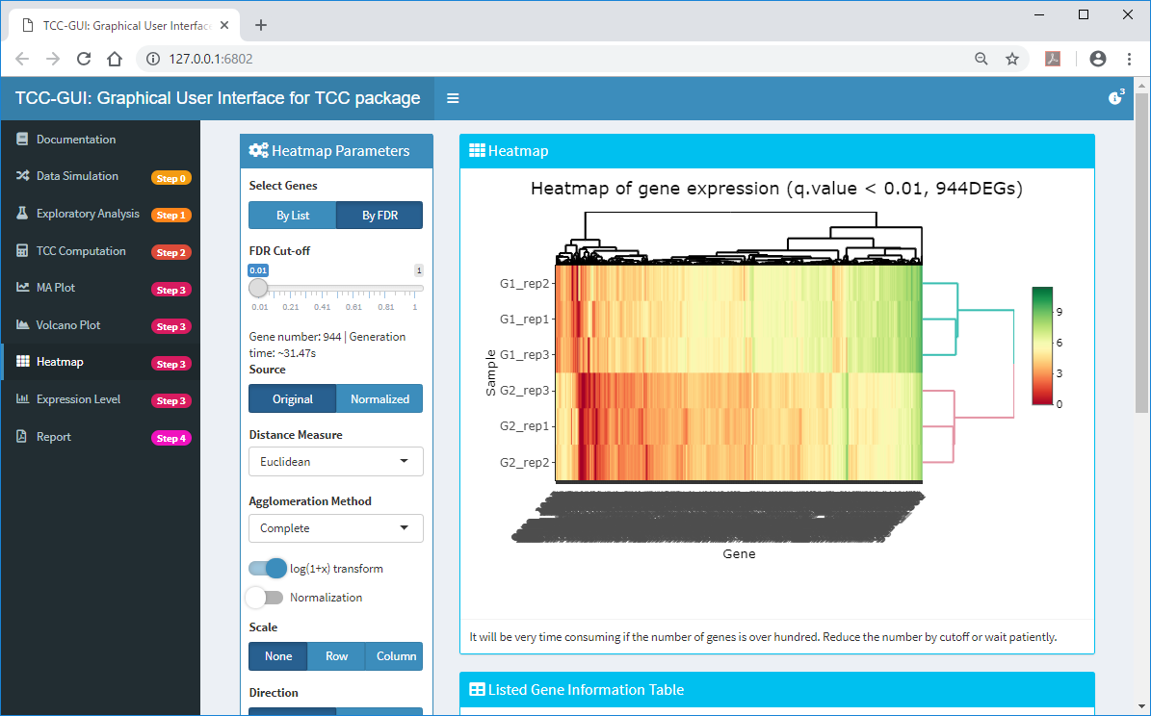
Heatmap generated
Since the 944 genes were differentially expressed between the two groups, hierarchical clustering on heatmap displays two distinct clusters as individual groups.

Slide 57
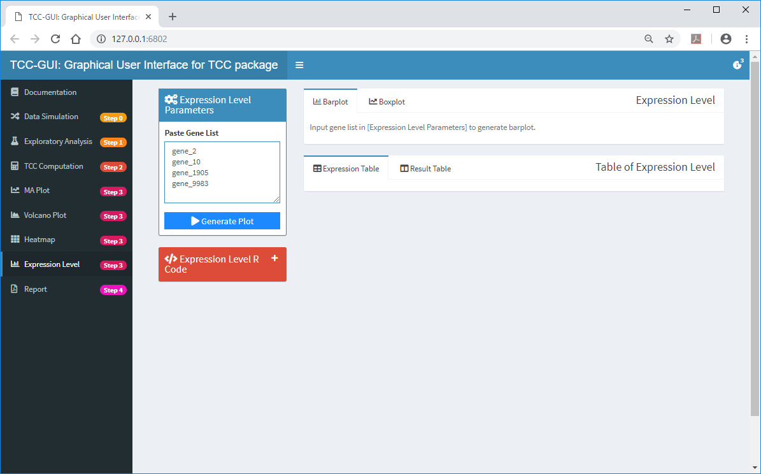
Expression Level
①Expression Level can be used to visualize expression patterns for genes of interest. ②We here apply the four genes. ③Generate Plot.
②
③
①

Slide 58
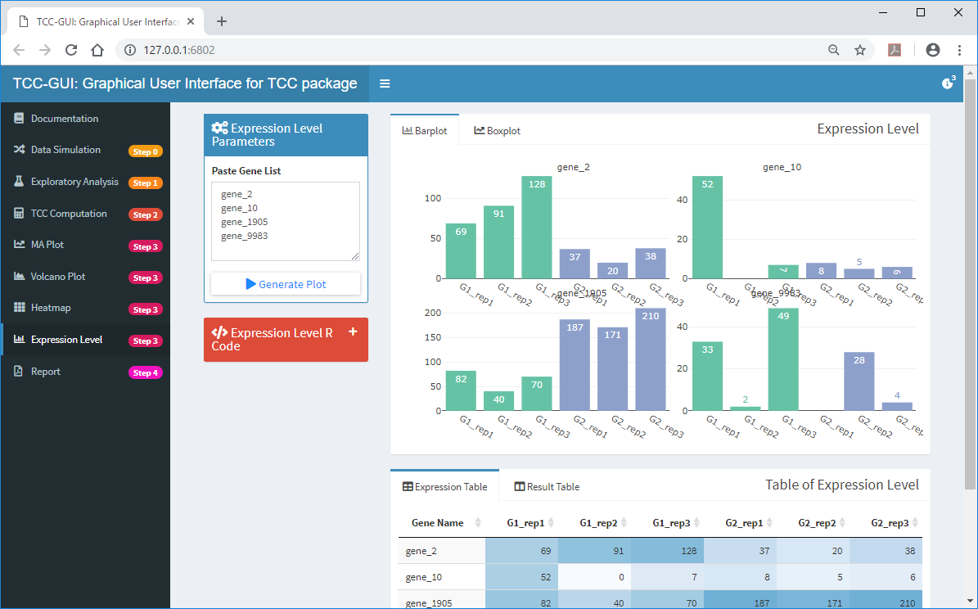
Expression Level generated
By default, ①Barplot and ②Expression Table are displayed.
①
②

Slide 59
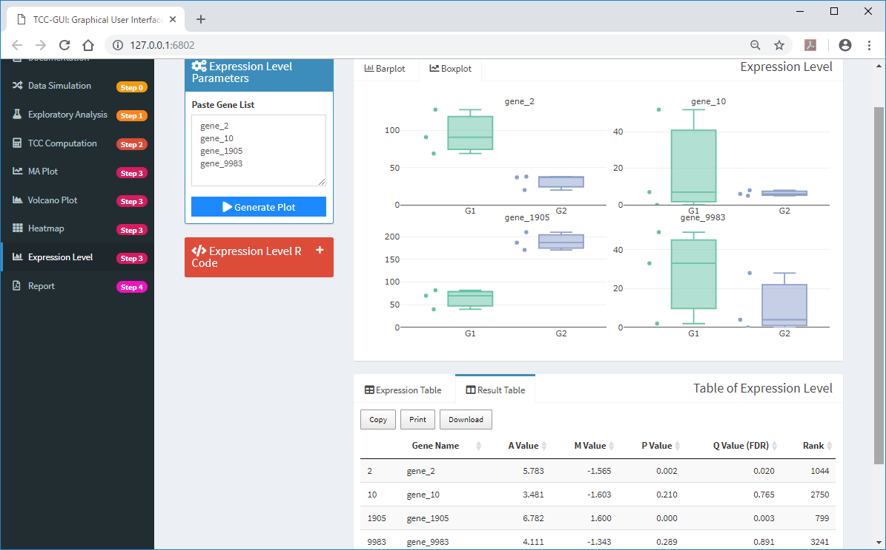
Expression Level generated
①Boxplot and ②Result Table can also be displayed.
①
②

Slide 60
Contents
TCC-GUI GitHub page
prerequisites, standalone version, and online version
Data Simulation (Step 0)
Exploratory Analysis (Step 1)
TCC Computation (Step 2)
Visualization (Step 3)
MA Plot, Volcano Plot
Heatmap, Expression Level
Report (Step 4)

Slide 61
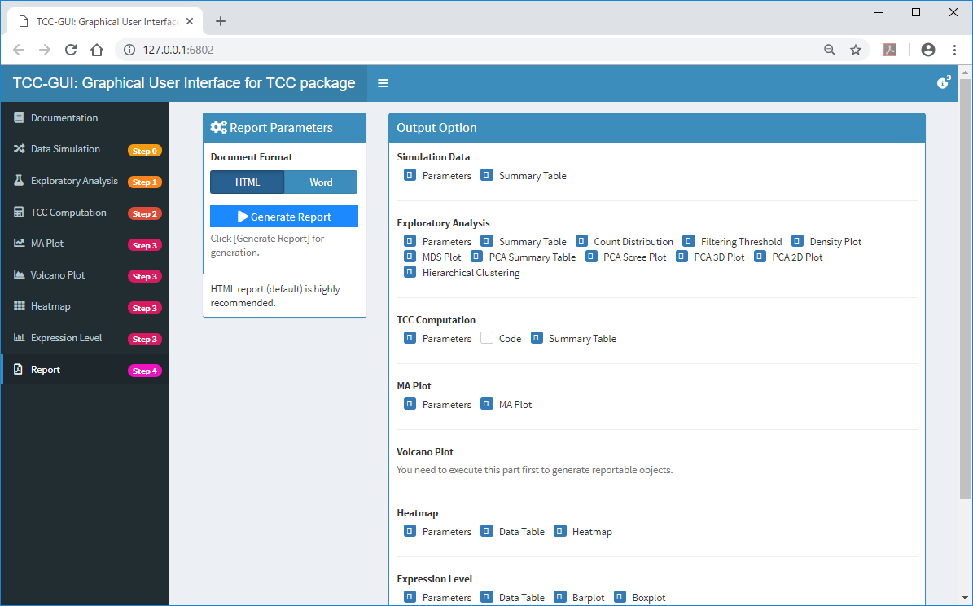
Step 4
While all the results including R codes can be saved in individual steps, some users may want to obtain these results as one file. To do this, ①move Step 4, and ②Generate Report.
③
①

Slide 62

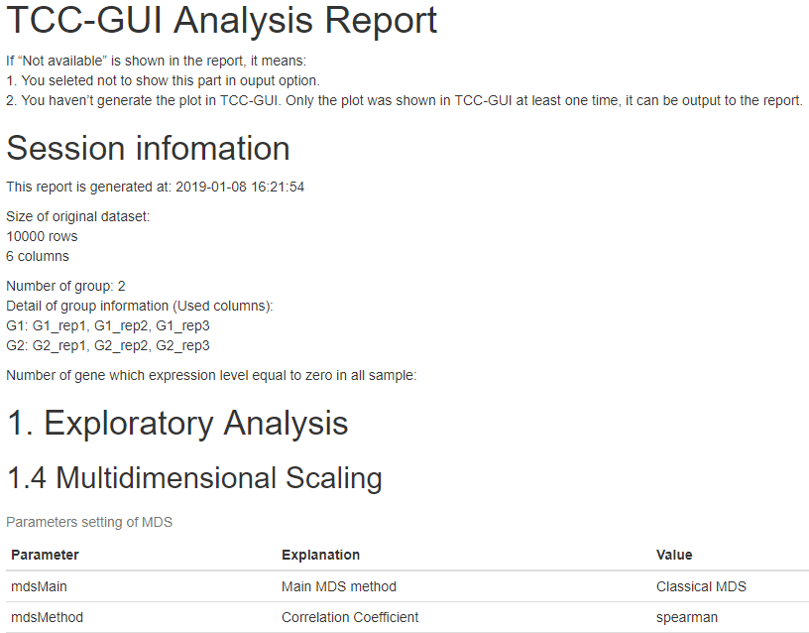
Report generated
①Download. The html report (Plot_Report.html) will be obtained. ②It contains like the red frame part.
②
①

